Slide 1
MICHIGAN ORACLE USERS SUMMIT 2021
Why You Should Consider an Oracle to Amazon RDS Migration
Presenter Name: Brandon Webb
Presenter Title: Senior Cloud Architect
COMPANY: Datavail
Monday October 25 – Thursday October 28, 2021
Virtual event

Slide 2
Save The DATE
MOUS 2022
October 26, 2022
Schoolcraft College - VisTaTech Center,
18600 Haggerty Rd, Livonia, MI
THANK YOU
WWW.MOUS.US

Slide 3
SURVEYS
Session Surveys
Please complete the session survey for this session using the Zoom session survey link.
The survey link will be provided via email once the webinar is closed.
THANK YOU
WWW.MOUS.US

Slide 4
Presenter
Brandon Webb
Senior Cloud Architect
Experience
5+ years Cloud Technologies
Accredited
AWS Associate Solutions Architect
Oracle Associate Solutions Architect
Masters in Information Systems

Slide 5
Datavail Overview
We are data specialists
Database Operations
Application Management
All major platforms: SQL Server, Oracle, DB2, MySQL, MongoDB, PostgreSQL, MariaDB, Cassandra, AWS, Azure
Comprehensive development & operational services
US & Global models
Reactive and proactive services
EBS/ERP
EPM
Hyperion/Essbase
Microsoft Dynamics
SharePoint
Custom development
Microsoft .NET
Oracle APEX
Databases, Analytics, and Application Data Integration
17+ years delivering data services
700+ customers with average client retention of 7 years
Analytics, Visualization & Integration
Managed services, projects, and staffing
Microsoft SSRS, SSIS, SSAS
PowerBI
Oracle OBIEE, BICS, GoldenGate
Informatica
Oracle Data Integrator
ETL development and operational run

Slide 6
Fill Out Evaluation Form
Fill out the Cloud Adoption survey for a chance to WIN Bose Audio Sunglasses with ear headphones & Bluetooth
https://www.techvalidate.com/registration/bdbc0b7e1d

Slide 7
Agenda
Patching, patching, patching...
How much space do you need... 5G... wait 10G... can you do 50G? Is that parameter right? Crap did we forget to add that?
Our DB is down, can you confirm? The load looks high...
Of course our backups are working...
It's the database... No way it's the server
Well, we trust them... We know them
Did we license everything correctly... oh no!

Slide 9
Agenda
Security
Administrative Tasks
Availability
Backup & Recovery
Performance
Automation
Licensing

Slide 10
WHY DO ALL THIS?... SAVINGS!
Licensing
Patching
Mistakes
Bad Hardware
Testing
Redundancy
Accounting
Software
Consolidate

Slide 11
What's a hacker's favorite season?

Slide 12
Phishing Season!

Slide 13
Security
Limited DBA User
Encryption
ACLs
SYS/SYSTEM Passwords
VPCs
No OS Management
Patching, patching, patching…

Slide 14
Amazon RDS encrypts your databases using keys you manage with the AWS Key Management Service (KMS). On a database instance running with Amazon RDS encryption, data stored at rest in the underlying storage is encrypted, as are its automated backups, read replicas, and snapshots. RDS encryption uses the industry standard AES-256 encryption algorithm to encrypt your data on the server that hosts your RDS instance.

Slide 15
Benefits of AWS
Security
No More Scheduling Patching
You state the schedule & AWS will patch the database for you

Slide 16
Administrative Tasks
Can I get more space?
That tablespace is full again
How big did you want that again...
Can I be added to the database

Slide 17
Benefits of AWS
Administrative Tasks
Configuration Management
Compliance
Standardization
Knowledge Transfer
Code Pipeline

Slide 18
Availability
“After All, No One Enjoys being Stood Up”
Standby Management
Cloud Endure
DMS (Data Migration Service)
Golden Gate

Slide 19
Benefits of AWS
Availability
Standby Management done by AWS
No more lagging/unknowns
Zone Preference/Region Solutions

Slide 20
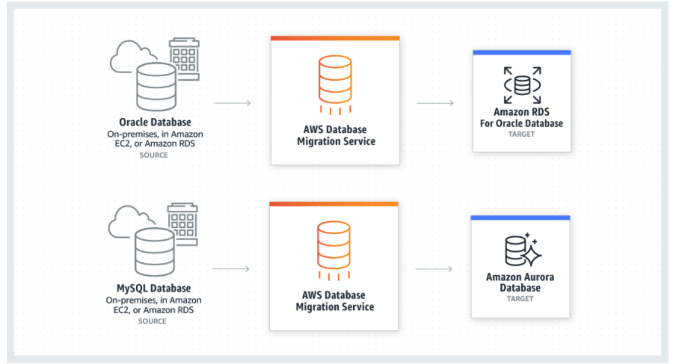
Database Migration Service
Benefits of AWS

Slide 21
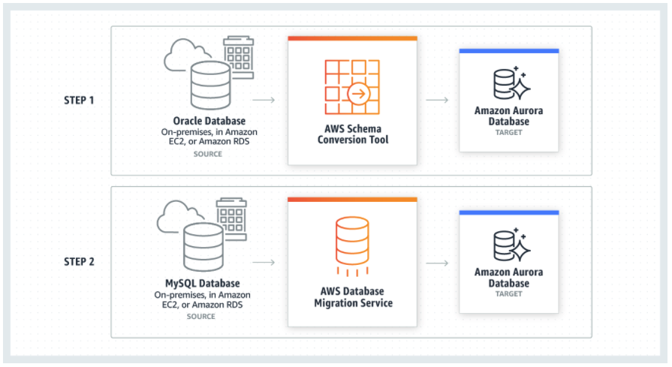
Schema Conversion Tool
Benefits of AWS

Slide 22
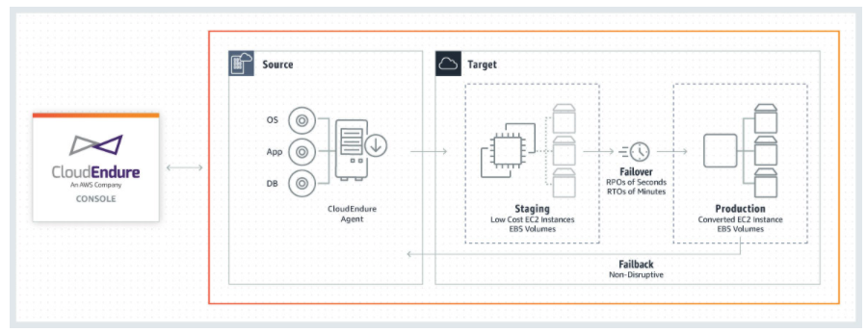
Availability
Benefits of AWS

Slide 23
Backup & Recovery
Automated Backups
Add <BRANDON WILL DO THIS PART>

Slide 24
Performance/Monitoring
Ability to Review Export Logs via the GUI
Downloadable Logs – No more mail -s
Cloudwatch Metrics for Alerting
Zoom In/Out Graphs for Analysis of Thresholds

Slide 25
Built in Graphs/Reports

Slide 26
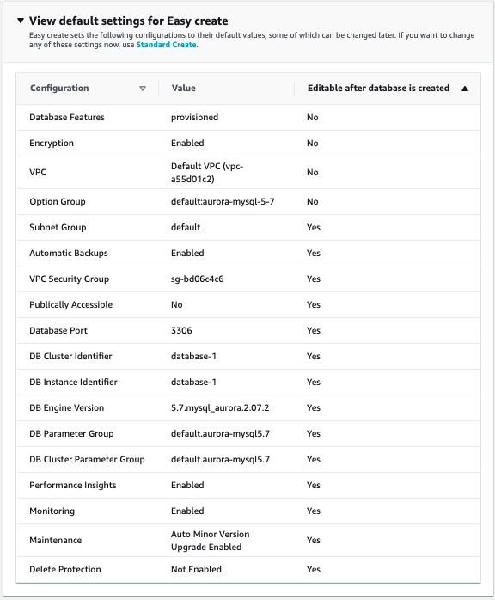
Automation
Automating File Transfers to Amazon RDS for Oracle databases
AWS CLI for automating database provisioning, spin up test/dev environments
aws rds create-db-instance \
--engine oracle-se1 \
--db-instance-identifier devinstance \
--allocated-storage 20 \
--db-instance-class db.m1.small \
--db-security-groups dbsecuritygroup \
--db-subnet-group dbsubnetgroup \
--master-username masterawsuser \
--master-user-password masteruserpassword \
--backup-retention-period 3

Slide 27
Licensing
You can run Amazon RDS for Oracle under two different licensing models – “License Included” and “Bring-Your-Own-License (BYOL)”.
In the "License Included" service model, you do not need separately purchased Oracle licenses; the Oracle Database software has been licensed by AWS.
On Demand VS Reserved Instances https://aws.amazon.com/rds/reserved-instances/

Slide 28
Questions & Discussion

Slide 29
Thank You

