Slide 1
MICHIGAN ORACLE USERS SUMMIT 2021
NEW FEATURES OF ORACLE E-BUSINESS SUITE UPGRADE 12.2.10
Presenter Name: John J Gomez
Presenter Title: Consultant
Company: Syntax
Monday October 25 – Thursday October 28, 2021
Virtual event

Slide 2
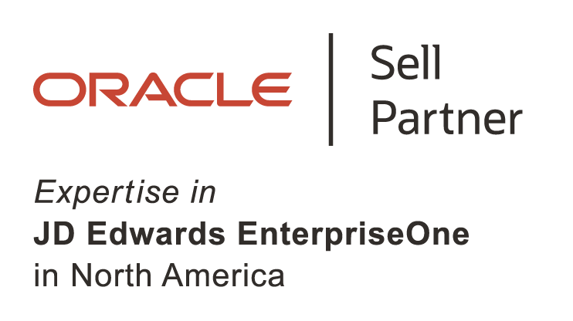
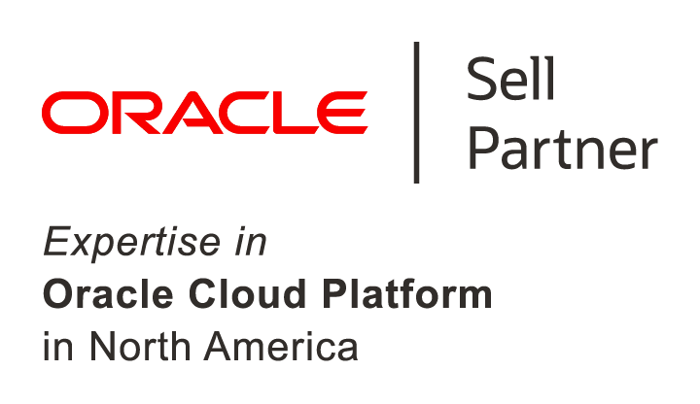
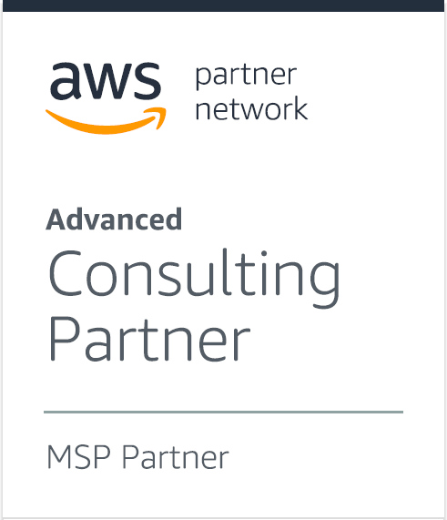
Overview
Syntax was founded in 1972 in Montreal, Canada. We have over 45 years of experience with ERP and ERP- related technologies.
Syntax is a full-service Cloud Managed Services and Disaster Recovery provider focused JD Edwards, E-Business Suite, and SAP.
Our Cloud solutions include public, private, and hybrid cloud featuring AWS, Azure, and Oracle.
Our ERP solutions include hosting, managed services, consulting and professional services, application managed services, and managed security services.
Syntax is a global company with offices and data centers in North, Europe, and Asia.
Notes:
These are the key differentiators for Oracle. You should tweak them based on the individual opportunity and competitive landscape.

Slide 3
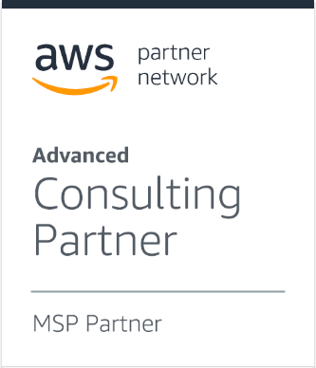
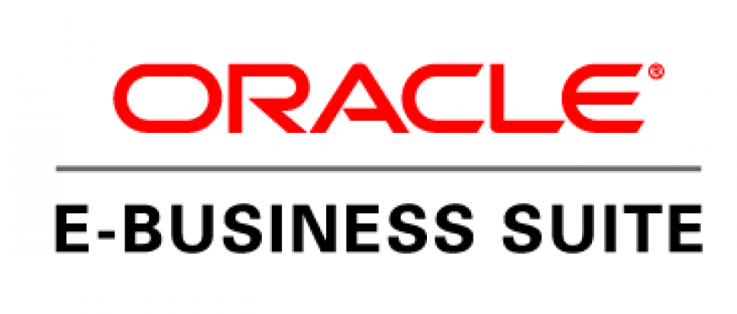
Syntax History
1972
1983
1997
2007
2017
2019
2020
2021
ERP Experts
IBM Infrastructure Experts
JD Edwards Partnership
#1 Cloud
Provider for JD Edwards
Core Services Acquisition
EMERALDCUBE Acquisition
FIT
Acquisition
AWS Partner Network Advanced Consulting Partner Managed Service Provider (MSP)
Linke Acquisition
Illuminiti
Acquisition
Notes:
1972
Implemented home grown ERP on IBM platform across North America.
1983
We partner with IBM and Oracle.
1999
Grew to be their #1 implementation partner.
2006
Enhanced Monitoring of the ERP.
2007
Oracle brands us as their #1 Cloud provider for JD Edwards - helps fuel our growth.
2017
Now we have a powerful and complete multiplatform ERP Cloud offering.
2019
To become the #1 Private ERP Cloud provider in the world.

Slide 4
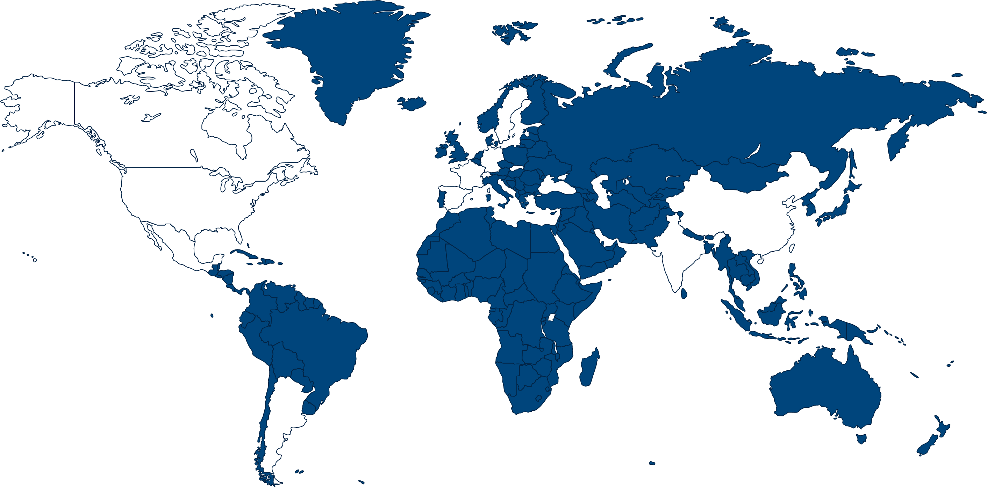
Syntax Global Capabilities
Canada
Weinheim
Sweden
Mutterstadt
H
Germany
SLOVAKIA
Montreal
France
Switzerland
Las Vegas
USA
Edison
Spain
Phoenix
China
North Carolina
Suzhou
Mexico
India
Office Location
Technical Support
Data Center
Argentina
Notes:
DCs:
1 in Montreal
1 in Phoenix
1 in Edison
2 in NC
1 in Las Vegas
4 in Weinheim Germany
1 in Mutterstadt Germany
2 in Suzho China
Offices:
Canada: Montreal
United States: New York, Rye, Edison, Alpharetta, Morrisville
Mexico: Puebla
Germany: Weinheim, Balingen, Eschborn
In Frankfurt there is no office with employees. It is the registered office of the company “Syntax Germany Acquisition GmbH”.
Slovakia: Košice
India: Mumbai, Hyderabad
China: Suzhou and Shanghai.
Suzhou is mainly operation center, DC is in Suzhou, around 70% of our employees are based there. Shanghai is mainly sales office.

Slide 5
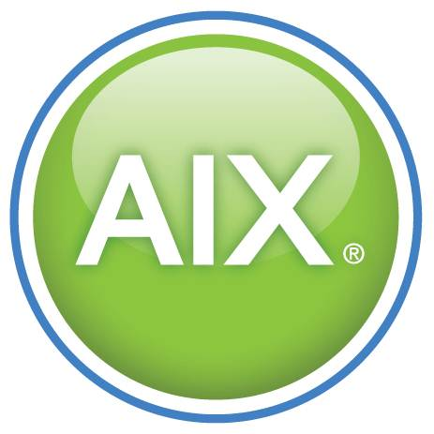
ORACLE APPLICATIONS
NON ORACLE APPLICATIONS
Remote Technical Managed Services
Other Oracle and 3rd-Party Apps
ORACLE ERP CLOUD SOLUTIONS
HYBRID/ PUBLIC CLOUD SOLUTIONS
Enterprise Application Managed Services
Enterprise Application Development & Enhancements
SOA and Middleware Development
Business Intelligence
Enterprise Planning and Advisory
APPLICATION MANAGED SERVICES
ASSOCIATED TECHNOLOGIES
Interfaces
Integrations
Replication Technologies
CONSULTING SOLUTIONS
License Sales
Implementations & Upgrades
Project Management
Technical Support
Functional Support
Training
Custom Programming
Notes:
Our job is to take care of your Mission Critical Applications – from Bare metal all the way up through the application layer. So you can focus on your business, while we focus on your IT infrastructure & Application availability & Performance
Very busy – but comprehensive

Slide 6
Speaker
John Gómez
Oracle EBS Project Manager
Over 20 years of Oracle ERP Experience
Completed numerous Oracle E-Business Suite implementations and upgrades
Experienced with multinational customers and multiple verticals
Techno/Functional Financials Expert (training/projects/webinars)

Slide 7
Agenda
New Features of Oracle E-Business Suite Upgrade 12.2.10
Upgrade Path
Enterprise Command Centers
EBS Mobile Release 9
EBS Cloud Manager

Slide 8
Upgrade Path
New Features of Oracle E-Business Suite Upgrade 12.2.10

Slide 9
Pre-Requisites
In order to upgrade to Release 12.2.10 you will need to assure that your database is at a minimum version of 11.2.0.4 or higher
Oracle recommends that your database be upgraded to the most current version either during your upgrade or immediately following it
The most current Long Term Release is 19c (DocID 742060.1)
There are also additional pre-upgrade steps and changes that will need to be executed on your database installation

Slide 10
Release 12.2.10
There are three different paths to follow when upgrading your environment to 12.2.10:
Please reference DocID: 2666934.1 for more information.
Path A
For users that are upgrading from the following releases: 11i, 12.0 or 12.1
Path B
For users that are upgrading from the following releases: 12.2.x
Path C
For users that are implementing a net new environment or reimplementing their current environment

Slide 11
Release 12.2.10
PATH
A
For users following this path, your environment is currently running either 11.5.10.2 or 12.0, 12.1
This path requires users to upgrade their existing environment to version 12.2.0. This upgrade introduces the dual file system concept as well as online patching. This portion of the upgrade can potentially impact any custom objects or extensions that may currently be installed. (CEMLI/RICEW)
Once the system is upgraded to 12.2.0, users will see the utilization of a run-time file system as well as a standby file system. The system is now ready to be upgraded to 12.2.10.
As this upgrade introduces fixes for current functionality as well as new functionality, it is highly recommended that the system undergo multiple regression testing rounds. Thorough testing of any customizations or extensions is recommended.

Slide 12
Release 12.2.10
PATH
B
For users following this path, your environment is currently running 12.2.x
Users on this path already have online-patching enabled. The system is already configured to use the run-time and standby file systems.
Users following this path can upgrade their current environments by applying the rollup patch for 12.2.10. The impact to your environment is diminished in comparison to Path A.
This upgrade will introduce fixes for existing functionality as well as new functionality, therefore it is highly recommended that the system undergo regression testing once the upgrade is complete to assure stability.

Slide 13
Release 12.2.10
PATH
C
For users that have chosen to implement a net new install or reimplement their current environment the following path is recommended.
Unlike other releases of EBS, 12.2.10 can not be installed independently. It must be applied on top of a 12.2.x environment. To this end it is necessary to start with an environment between 12.2.4 to 12.2.8. Release 12.2.9 and 12.2.10 are roll-up patches only.
Once you have chosen your base environment you would the apply the 12.2.10 roll-up patch. You can then proceed with your environment as you would with any other net-new implementation.

Slide 14
Enterprise Command Centers
New Features of Oracle E-Business Suite Upgrade 12.2.10

Slide 15
Enterprise Command Centers
Oracle EBS Release 12.2.10 takes advantage of the Enterprise Command Center Framework.
This framework is what provides the backbone for the functionality within the different Command Centers that are available out of the box. It is also what provides the ability to extend these dashboards based on your business needs.
The Enterprise Command Center Framework and related Dashboards do not come setup out of the box and will require additional configuration in your environment.
You may reference the following note to assist you with accomplishing this DocID: 2495053.1

Slide 16
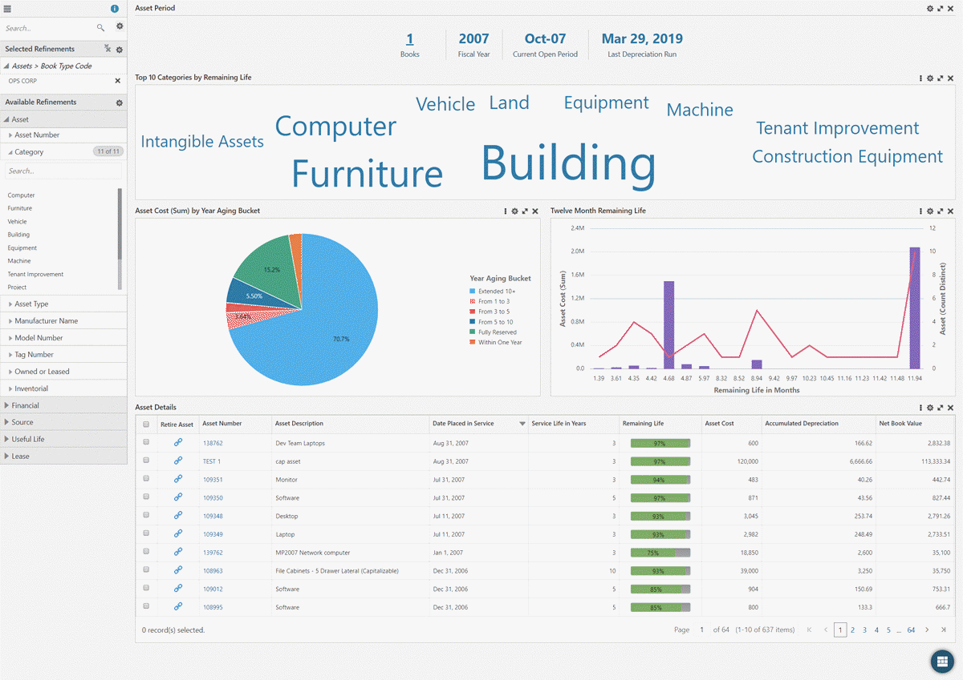
Assets Command Center
The Oracle Assets Command Center helps asset personnel discover information across all relevant Asset processes in the enterprise and make that data available for analysis and search.
Operational efficiency and insight is greatly enhanced through key metrics, drillable graphs, and tag clouds enabling asset personnel to quickly identify problem areas and outstanding items that require intervention. Decision making is improved through immediately actionable information and streamlined end to end processing of exceptions and bottlenecks. Asset personnel can efficiently navigate to the underlying application to take corrective action as necessary.
The Oracle Assets Command Center feature is available at no additional cost to licensed users of Oracle Financials.

Slide 17
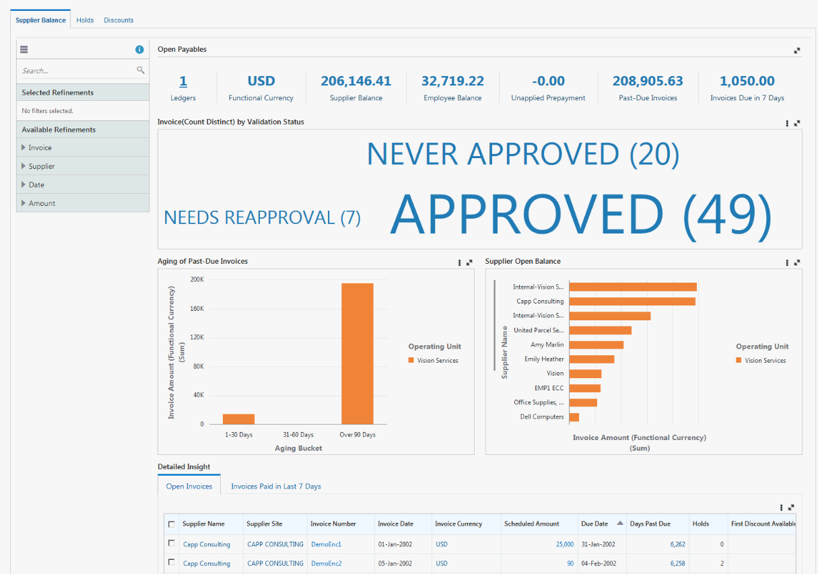
Payables Command Center
Oracle Payables Command Center empowers accounts payable personnel to maximize productivity on a variety of end to end business processes by providing powerful search and sophisticated guided navigation capabilities.
Operational efficiency and insight is greatly enhanced through key metrics, drillable graphs, and tag clouds enabling you to quickly identify problem areas and outstanding items that require intervention along with effective navigation to the underlying application to take corrective action as necessary.
The Oracle Payables Command Center feature is available at no additional cost to licensed users of Oracle Financials.

Slide 18
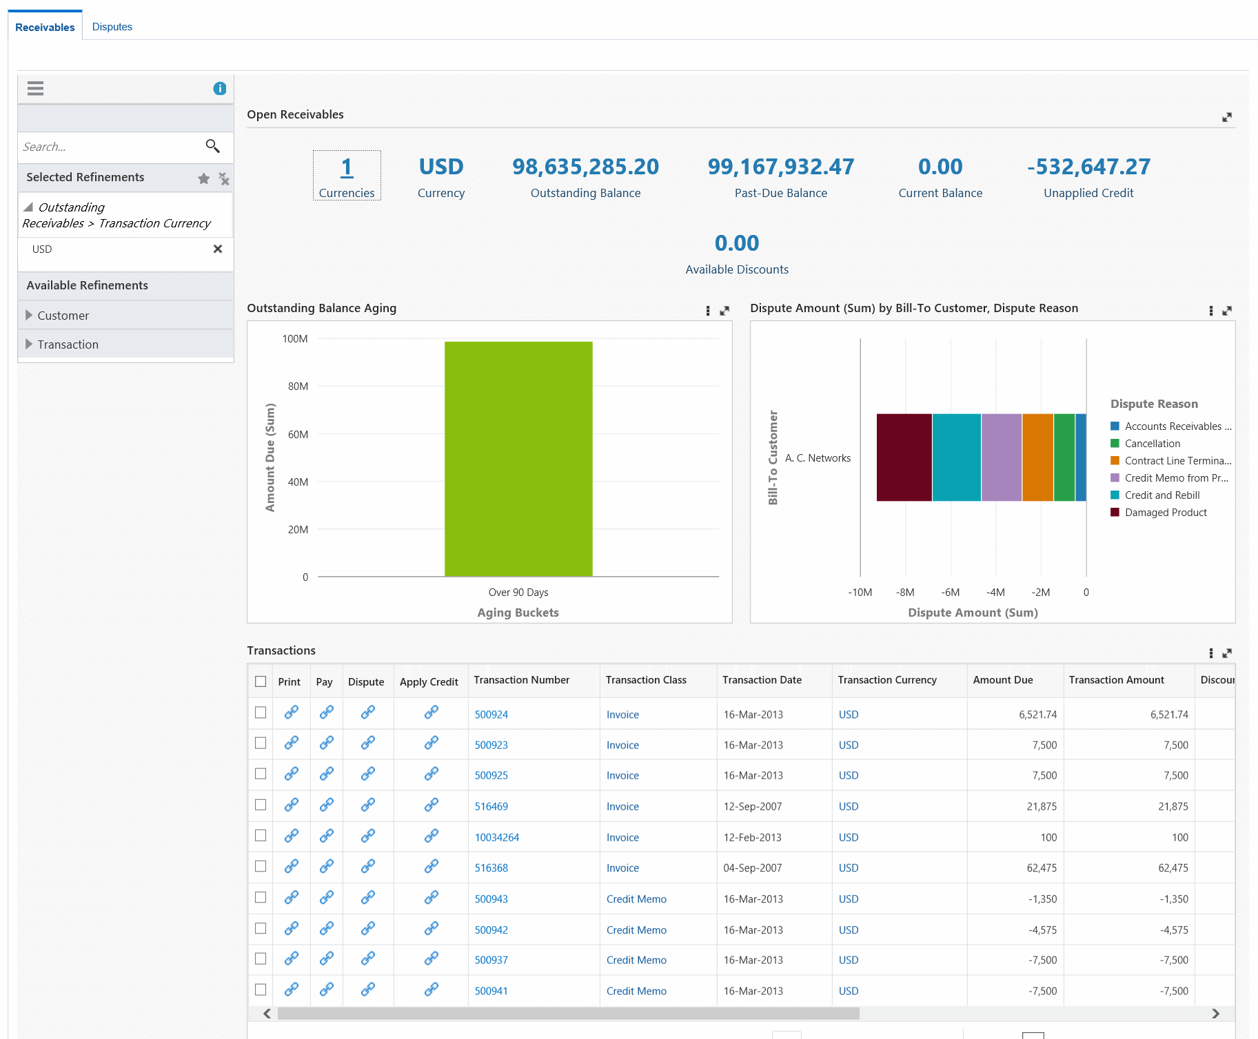
Receivables Command Center
The Oracle Receivables Command Center provides actionable insights across a number of dashboards that contain metrics, drillable charts and graphs and other data to help accounts receivable and collections personnel to discover important information quickly such as past due balances and top 10 customers with highest outstanding balances.
The Oracle Receivables Command Center improves decision making through immediately actionable information and streamlines end to end processing of exceptions and bottlenecks. Accounts receivable and collections personnel can efficiently navigate to the underlying application to take corrective action as necessary.
The Oracle Receivables Command Center feature is available at no additional cost to licensed users of Oracle Financials.

Slide 19
Mobile Release 9
New Features of Oracle E-Business Suite Upgrade 12.2.10

Slide 20
Mobile Release 9
As part of Oracle’s push to expand the functionality of E-Business Suite applications, they created a Mobile Foundation. This Mobile Foundation is a series of technical and functional features on the server that allow for the connectivity and usability of mobile Applications.
The Mobile Foundation allows for the utilization of Apple iOS and Android OS devices with E-Business Suite Applications.
Mobile Release 9 is the most current version of these tools.
For further information you may access MyOracleSupport Doc ID: 1642431.1

Slide 21
Mobile Applications
Many of the mobile applications that can be utilized with E-Business Suite release 12 can be administered and configured through the Mobile Applications Administrator. There are, however, some applications that do not utilize this functionality. While most of the applications that are available utilize the Mobile Application Foundation to communicate and interact with EBS not all of them do
The following are applications that do not use the Mobile Application Foundation as well as their associated documentation:
Oracle Fusion Expenses (Document 1625446.1)
Oracle Mobile Field Service (Document 1564644.1)
Oracle Mobile Service Manager for Oracle E-Business Suite (Document 2107368.1)
Oracle Mobile Supply Chain Applications for Oracle E-Business Suite (Document 2108155.1)
21
New Features of Oracle E-Business Suite Upgrade 12.2.10 | Confidential & Proprietary

Slide 22
EBS Cloud Manager
New Features of Oracle E-Business Suite Upgrade 12.2.10

Slide 23
EBS or Software as a Service?
With the growing number of cloud vendors, many customer are now trying to decide what that means for their current environments. Do they continue with eBusiness Suite or migrate to Software as a Service (SaaS) type applications.
Many customers have made a large investment in their ERP software and are hesitant to have to make another large expenditure in migrating to a new platform such as SaaS applications. These customers also tend to have unique needs which aren’t always easily met by standardized solutions.
The decision to migrate is one that will be with us for quite a while as SaaS applications mature.

Slide 24
EBS in the Cloud
Some customers have decided that they will take advantage of the cloud but stay with their existing EBS environment. This is a popular decision thanks to the choice of different types of cloud platforms that are available.
Many Syntax clients currently utilize this model. They are either hosted in our private cloud or one of our other available cloud platforms.
With 12.2.10 you can now use the EBS Cloud Manager application to help you with managing some of this workload. Working with your cloud provider, like Syntax, you can now manage different environments through a central User Interface. This gives you the redundancy of the cloud with the ability to manage your existing EBS environments.

Slide 25
Oracle eBusiness Suite Cloud Manager

Slide 26
Recommended Links
Oracle Mobile Applications Administrator https://docs.oracle.com/cd/E18727_01/doc.121/e64384/T656045T656049.htm
Oracle EBS Cloud Manager
https://docs.oracle.com/cd/E26401_01/doc.122/f35809/T679330T679339.htm
Oracle E-Business Suite Product Specific Release Notes, Release 12.2.10 (Doc ID 2666850.1)
https://blogs.oracle.com/ebsandoraclecloud/try-our-new-ebs-cloud-manager-virtual-hands-on-lab

Slide 27
Q&A
New Features of Oracle E-Business Suite Upgrade 12.2.10

Slide 28
Contact Us
Syntax provides end-to-end Oracle E-Business Suite technical and functional solutions that are prescriptive and help drive best practices, automation, and tooling to ensure peak performance, high availability, and security.
CONTACT US TODAY TO LEARN MORE ABOUT OUR SOLUTIONS FOR ORACLE E-BUSINESS SUITE.
Hosting and Managed Services
Upgrades and Implementations
Monitoring and Service Desk
Performance Tuning and Optimization
Cloud Migrations (private, public, hybrid)
Security Managed Services
syntax.com
We have over 40 years of Oracle ERP experience and over 25 years providing cloud and managed services for Oracle E-Business Suite applications featuring best-of-breed private and public cloud offerings.
marketing@syntax.com

Slide 29
Contact Us
Syntax provides end-to-end Oracle E-Business Suite technical and functional solutions that are prescriptive and help drive best practices, automation, and tooling to ensure peak performance, high availability, and security.
We have over 40 years of Oracle ERP experience and over 25 years providing cloud and managed services for Oracle E-Business Suite applications featuring best-of-breed private and public cloud offerings.
Syntax provides end-to-end Oracle E-Business Suite technical and functional solutions that are prescriptive and help drive best practices, automation, and tooling to ensure peak performance, high availability, and security.
Hosting and Managed Services
Upgrades and Implementations
Monitoring and Service Desk
Performance Tuning and Optimization
Cloud Migrations (private, public, hybrid)
Security Managed Services
Hosting and Managed Services
Upgrades and Implementations
Monitoring and Service Desk
Performance Tuning and Optimization
Cloud Migrations (private, public, hybrid)
Security Managed Services
CONTACT US TODAY TO LEARN MORE ABOUT OUR SOLUTIONS FOR ORACLE E-BUSINESS SUITE.
www.syntax.com
marketing@syntax.com

Slide 30
Thank You
syntax.com

Slide 31
Save The DATE
ASCEND CONFERENCE 2022
June 12-15, 2022
the Aria in Las Vegas, NV
https://ascendusersconference.com
MOUS 2022
October 26, 2022
Schoolcraft College - VisTaTech Center,
18600 Haggerty Rd, Livonia, MI
https://www.mous.us
THANK YOU
www.mous.us

Slide 32
SURVEYS
Session Surveys
Please complete the session survey for this session using the Zoom session survey link.
The survey link will be provided via email once the webinar is closed.
THANK YOU
WWW.MOUS.US

