Slide 1
MICHIGAN ORACLE USERS SUMMIT 2021
Oracle 19C Automatic Indexing - Inside & Out
Presenter Name: Janis Griffin
Presenter Title: Senior System Consultant
COMPANY: Quest Software
Monday October 25 – Thursday October 28, 2020
Virtual event

Slide 2
Who Am I
Senior Sales Engineer / DBA
Janis.Griffin@Quest.com
Twitter® - @DoBoutAnything
Current – 30+ Years in Oracle®, DB2®, ASE, SQL Server®, MySQL®
DBA and Developer
Specialize in Performance Tuning
Review Database Performance for Customers Common Question – How do I tune it?

Slide 3
Agenda
19c Automatic Indexing – What is it?
High Level Steps
Capture
Verify
Decide
Monitor
Report
DBMS_AUTO_INDEX Package
19c Automatic Indexing – How It Works
Several Case Studies
How to drop Automatic Indexes

Slide 4
19c Automatic Indexing – What is it?
Implements indexes based expert index tuning knowledge
Identifies ‘candidate indexes’ based on table column usage
Without DBA involvement
Except for DBA can set preferences
View report of indexes and their impact on the application
Works incrementally
Needs to be iterative and continuous
Created as invisible
Uses ‘SYS_AI’ as the name prefix
Automatic indexes are tested
If improved performance – indexes made visible
If no improvement – indexes are marked unusable
Later removed

Slide 5
19c Automatic Indexing High Level Steps
No DBA interaction
All tuning activities
Auditable via reporting
Capture
Monitor
Identify
Online Validation
Verify
Decide

Slide 6
19c Automatic Indexing – How It Works
Capture
Captures the application SQL history into a SQL repository
Includes SQL, plans, bind values, execution statistics, etc.
Identify Candidate Indexes
That may help the newly captured SQL statements
Creates indexes as unusable invisible indexes
Metadata only
Drops indexes obsoleted by newly created indexes (logical merge)
Verify
Ask optimizer if index candidates will be used for captured SQL statements
Materialize indexes and run SQL to validate that performance improved
All verification is done outside application workflow
Capture
Monitor
Identify
Online Validation
Verify
Decide

Slide 7
19c Automatic Indexing – How It Works
Decide
If performance is better for all statements, indexes are marked visible
If performance worse for all statements, indexes remain invisible
If performance worse for some statements
Indexes are marked visible except for SQL statements that regressed
Online Validation
Validation of new indexes continues for other statements online
Only one of the sessions executing a SQL statement
is allowed to use the new indexes
Monitor
Index usage is continuously monitored
Automatically created indexes will be dropped if not used in a long time
Capture
Monitor
Identify
Online Validation
Verify
Decide

Slide 8
19c Automatic Indexing Benefits
Great for OLTP, OLAP, mixed workloads but critical for OLTP
Applies to tuned and un-tuned applications
If tuned
Existing secondary indexes may be outdated
Important indexes are missing
Some secondary indexes can be dropped and auto indexes can be added
If un-tuned
Existing indexes support primary and unique key constraints
Can be used in all stages of application lifecycle
Support single and concatenated indexes
Function-based indexes
Compression advanced low
Capture
Monitor
Identify
Online Validation
Verify
Decide

Slide 9
19c Automatic Indexing
Automatic indexing defaults to run in same database as application
Indexing task consumes CPU, memory and storage
Resource manager plan limits task to 1 CPU
DBA can control
Which temp tablespace is used to build indexes
Which tablespace and how much space can be used by auto indexing
Production Database
CPU Task
Memory Build
Storage Store

Slide 10
Automatic Indexing Requirements
Feature is only available to Enterprise Edition on Engineered Systems
Exadata only
Workaround for testing
In CDB as sysdba
Alter system set “_Exadata_feature_on”=true scope=spfile;
Shutdown immediate;
Startup
Unfortunately this is not supported
Don’t use on real system
Notes:
This is not supported and shouldn't be used on a real system.

Slide 11
19c DBMS_AUTO_INDEX Controls Auto Indexing
Automatic indexing procedures
CONFIGURE
AUTO_INDEX_MODE – Turns on, off or report only
IMPLEMENT - Turns on automatic indexing
New indexes that improve performance are made visible & used by optimizer
REPORT ONLY -Turns on automatic indexing
New indexes remain invisible
OFF - Turns off automatic indexing
AUTO_INDEX_SCHEMA
Can include/exclude schemas using ALLOW parameter
Is case sensitive & can use wildcards
If NULL, all schemas can use auto index
AUTO_INDEX_RETENTION_FOR_AUTO
Number of days (default 373) auto indexes retained after last used date
AUTO_INDEX_RETENTION_FOR_MANUAL
Number of days (default NULL) manual indexes retained after last used date
AUTO_INDEX_DEFAULT_TABLESPACE
DROP_SECONDARY_INDEXES
Deletes all the indexes, except the ones used for constraints
From a schema or a table
REPORT_ACTIVITY
Returns a report of automatic indexing operations
Executed during a specific period
REPORT_LAST_ACTIVITY - Returns a report of the latest operation
Holds schema names(s) to be exclude from auto indexing
Default is all tables in all user created schemas
AUTO_INDEX_RETENTION_FOR_MANUAL
Number of days (default NULL) manual indexes retained after last used date
AUTO_INDEX_DEFAULT_TABLESPACE
Tablespace name where auto indexes will be stored (user default tablespace)
AUTO_INDEX_MODE
Put automatic indexing into reporting mode (default=implement)
Indexes are created, tested, and a report shows the impact without affecting the app
Notes:
Returns a report of the automatic indexing operations executed during a specific period in a database
IMPLEMENT : Turns on automatic indexing. New indexes that improve performance are made visible and available for use by the optimizer.
REPORT ONLY : Turns on automatic indexing, but new indexes remain invisible.
OFF : Turns off automatic indexing.
Deletes all the indexes, except the ones used for constraints, from a schema or a tabl

Slide 12
Configure.Auto_Index_Mode Example

Slide 13
Configure.Auto_Index_Schema Example
COLUMN parameter_name FORMAT A40
COLUMN parameter_value FORMAT A15
SELECT parameter_name, parameter_value
FROM cdb_auto_index_config
ORDER BY 1, 2;

Slide 14
DBMS_AUTO_INDEX.CONFIGURE - Cont.
CONFIGURE
AUTO_INDEX_RETENTION_FOR_AUTO
Number of days (default 373) auto indexes retained after last used date
AUTO_INDEX_RETENTION_FOR_MANUAL
Number of days (default NULL) manual indexes retained after last used date
AUTO_INDEX_REPORT_RETENTION
Number of days automatic indexing logs are retained before deletion
Automatic indexing report is based of the logs (Default is 31 days)
AUTO_INDEX_DEFAULT_TABLESPACE
Tablespace to use to store auto indexes (Default is NULL)
AUTO_INDEX_SPACE_BUDGET
Percentage of tablespace size to use for auto indexes
Can only be used when using default tablespace is used
Notes:
Configure parameters:
Automatic indexing configuration setting. It can have one of the following values:
AUTO_INDEX_MODE: Modes of operation of auto indexes. It can have one of the following values:
IMPLEMENT: In this mode, new auto indexes are created as visible indexes and any existing invisible auto indexes are also set to visible indexes. In this mode, auto indexes are available to be used in SQL statements.
REPORT ONLY: In this mode, new auto indexes are created as invisible indexes and are not available to be used in SQL statements.
OFF: Setting the mode to OFF prevents new auto indexes from being considered and created. However, it does not disable existing auto indexes.
AUTO_INDEX_SCHEMA: Schemas to include or exclude from using auto indexes. Its value is case-sensitive and can include wildcards. Its behavior is controlled by the allow parameter.
The automatic indexing process manages two schema lists – the inclusion list and the exclusion list. The inclusion list contains the schemas that can use auto indexes. The exclusion list contains the schemas that cannot use auto indexes. Initially, both these lists are empty and all the schemas in the database can use auto indexes when automatic indexing is enabled for a database.
If the inclusion list contains at least one schema, then only the schemas listed in the inclusion list can use auto indexes.
If the inclusion list is empty and the exclusion list contains at least one schema, then all the schemas can use auto indexes, except the schemas listed in the exclusion list.
If both the lists (the inclusion list and the exclusion list) contain at least one schema, then all the schemas can use auto indexes, except the schemas listed in the exclusion list.
AUTO_INDEX_RETENTION_FOR_AUTO: Number of days for which the unused auto indexes are retained in the database, after which they are deleted. Default value is 373 days.
AUTO_INDEX_RETENTION_FOR_MANUAL: Number of days for which the unused manually created indexes (non-auto indexes) are retained in the database, after which they are deleted. When it is set to NULL, the manually created indexes are not deleted by the automatic indexing process. Default value is NULL.
AUTO_INDEX_REPORT_RETENTION: Number of days for which automatic indexing logs are retained in the database before they are deleted. As automatic indexing report is generated based on these logs, automatic indexing report cannot be generated for a period beyond the value specified for AUTO_INDEX_REPORT_RETENTION. Default value is 31 days.
AUTO_INDEX_DEFAULT_TABLESPACE: Tablespace to use to store auto indexes. Default is NULL, which means the default permanent tablespace specified during the database creation is used to store auto indexes.
AUTO_INDEX_SPACE_BUDGET: Percentage of tablespace size to use for auto indexes. This configuration setting can be used only when the default tablespace specified during the database creation is used for storing auto indexes.

Slide 15
DBMS_AUTO_INDEX.CONFIGURE - Cont.
CONFIGURE additional commands
PARAMETER_VALUE is specific to parameter
If NULL, setting is assigned a default value
AUTO_INDEX_COMPRESSION enables/disables advanced compression
ON for Advanced Low Compression
OFF for no compression (Default)
ALLOW for AUTO_INDEX_SCHEMA parameter
TRUE adds the specified schema to the inclusion list
FALSE adds the schema to the exclusion list
NULL remove the schema from the list that it is currently added
Notes:
parameter_value
Value for the configuration setting specified in parameter_name.
When it is set to NULL, the configuration setting is assigned the default value.
auto_index_compression Values to enable and disable advanced index compression for auto indexes. The supported values are: ON: to enable advanced index compression for auto indexes
OFF: to disable advanced index compression for auto indexes
The default value is OFF.
allow
This parameter is applicable only for the AUTO_INDEX_SCHEMA configuration setting and it can have one of the following values:
TRUE: Add the specified schema to the inclusion list.
FALSE: Add the specified schema to the exclusion list.
NULL: Remove the specified schema from the list to which it is currently added.
Refer to the description of the AUTO_INDEX_SCHEMA configuration setting for more information about the inclusion list and the exclusion list.

Slide 16
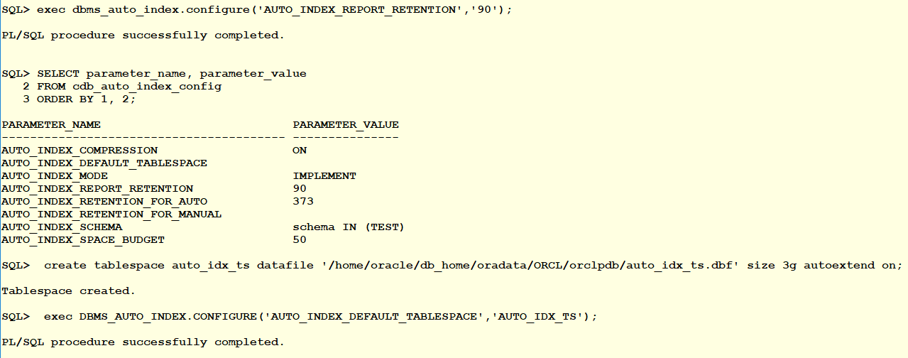
DBMS_AUTO_INDEX.CONFIGURE Examples

Slide 17
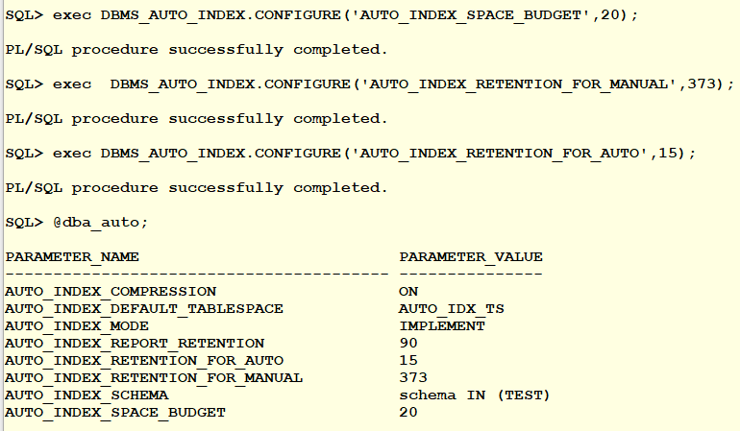
DBMS_AUTO_INDEX.CONFIGURE Examples

Slide 18
New (CDB/DBA) Views for Auto Indexes
DBA_AUTO_INDEX_CONFIG *
Display the current configuration of the automation index
DBA_AUTO_INDEX_EXECUTIONS
History of Automatic Indexing task executions
DBA_AUTO_INDEX_IND_ACTIONS
Actions performed on automatic indexes (e.g create, rebuild, etc…)
DBA_AUTO_INDEX_SQL_ACTIONS
Actions performed on SQL to verify automatic indexes
DBA_AUTO_INDEX_STATISTICS
Shows statistics related to automatic indexes
DBA_AUTO_INDEX_VERIFICATIONS
Shows statistics about PLAN_HASH_VALUE (original buffer gets, etc…)

Slide 19
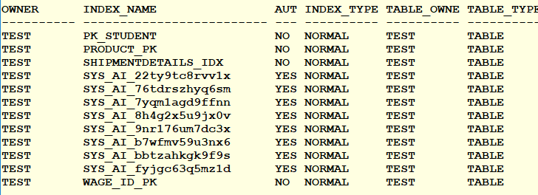
Additional Views for Auto Indexes
DBA_ADVISOR_TASKS – new tasks
DBA_INDEXES – new column (AUTO)
SELECT owner,
index_name,
auto,
index_type,
table_owner,
table_type
FROM dba_indexes
WHERE table_owner = 'TEST’
-- WHERE auto='YES'
ORDER BY owner, index_name;

Slide 20
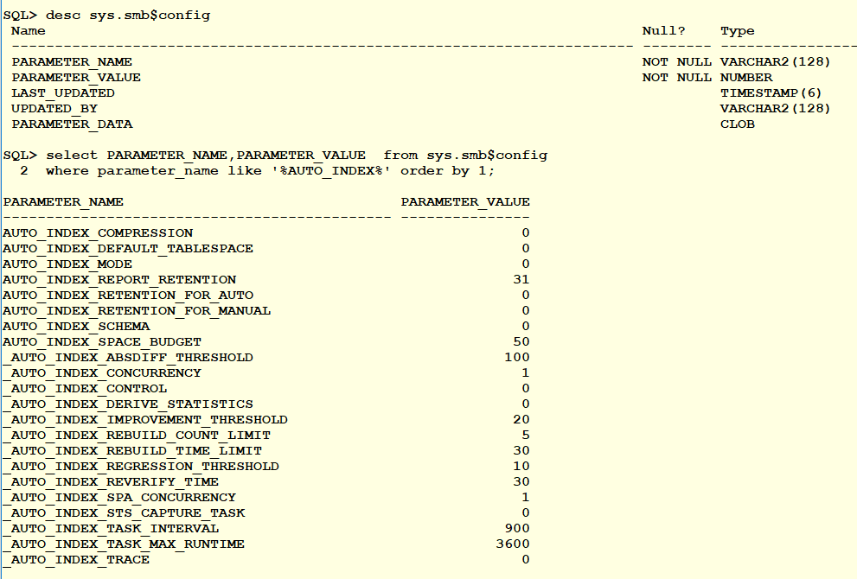
SMB$CONFIG Table
Shows both documented & undocumented settings for Auto Indexes

Slide 21
Other DBMS_AUTO_INDEX Procedures
DROP_SECONDARY_INDEXES
Deletes all the indexes, except the ones used for constraints
From a schema or a table
Example - begin dbms_auto_index.drop_secondary_indexes('SH'); end;
REPORT_ACTIVITY
Returns a report of automatic indexing operations
Executed during a specific period
declare
report clob :=null;
begin
report :=DBMS_AUTO_INDEX.REPORT_ACTIVITY (
activity_start => TO_TIMESTAMP('2020-01-01', 'YYYY-MM-DD'),
activity_end => TO_TIMESTAMP('2020-01-31', 'YYYY-MM-DD'),
type => 'TEXT',
section => 'SUMMARY',
level => 'BASIC');
dbms_output.put_line(report);
end;
REPORT_LAST_ACTIVITY - Returns a report of the latest operation
SELECT DBMS_AUTO_INDEX.report_activity(
activity_start => SYSTIMESTAMP-1,
activity_end => SYSTIMESTAMP,
type => 'TEXT’,
section => 'ALL’)
FROM dual;
Notes:
Show last 24 hours
declare
report clob := null;
begin
report := dbms_auto_index.report_activity();
dbms_output.putline(report);
end;

Slide 22
19c Automatic Indexing Reporting & Hints
Each auto index task generates a report
Reports can be generated via
DBMS_AUTO_INDEX.REPORT_ACTIVITY function
Date/Time range
Format (XML, HTML, Text)
Level (basic, typical, all)
Section
Summary, Index Details,
Verification Details, Errors, All
Use hints to control auto indexes
/*+ USE_AUTO_INDEXES */
/*+ NO_USE_AUTO_INDEXES */

Slide 23
Report_Activity Example

Slide 24
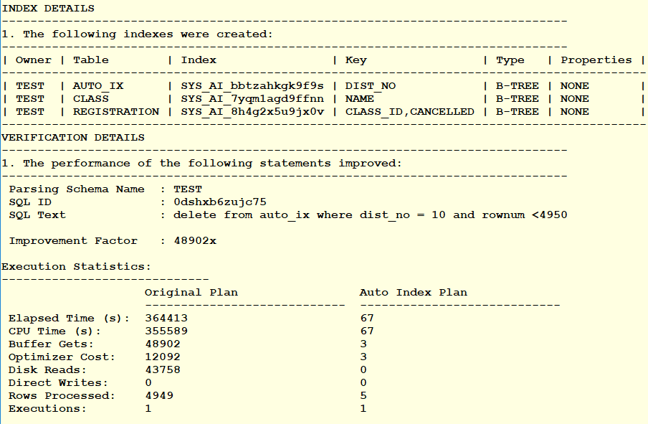
Report_Activity Cont.

Slide 25
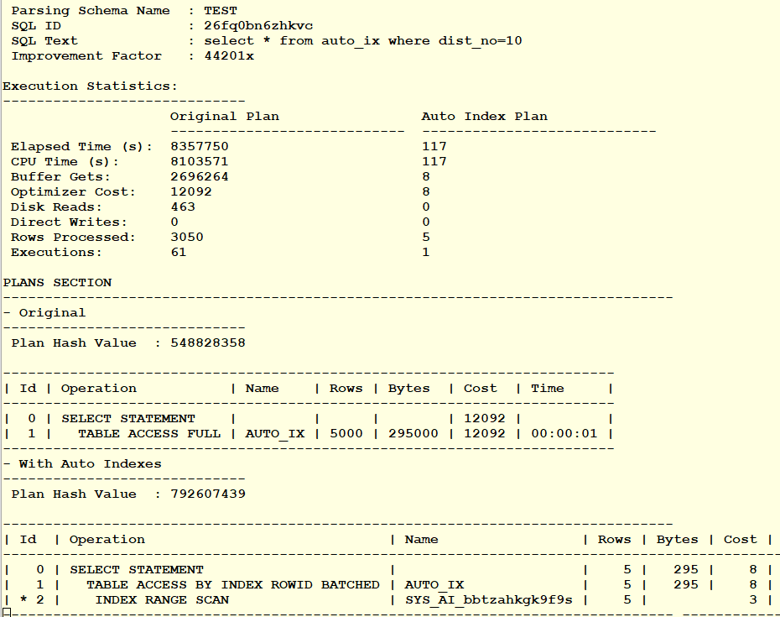
Report_Activity Cont.

Slide 26
Other DBMS_AUTO_INDEX Procedures
REPORT_LAST_ACTIVITY - Returns a report of the latest operation
declare
report clob := null;
begin
report := DBMS_AUTO_INDEX.REPORT_LAST_ACTIVITY (
type => 'TEXT',
section=> 'ALL',
level=> 'TYPICAL');
dbms_output.put_line(report);
end;
Type can be TEXT (default), HTML or XML
Section can be SUMMERY, INDEX_DETAILS,VERIFICATION_DETAILS, ERROR or ALL
Can combined
SUMMARY + INDEX_DETAILS – shows summary and index_details
ALL – ERRORS – shows every section except errors
Level = Basic, Typical or All
select dbms_auto_index.report_last_activity() from dual;
Notes:
Examples
The following example generates a typical report of the last automatic indexing operation executed in a database. The report is generated in the text format and contains all the sections (summary details, auto index details, auto index verification details, and error details).
declare report clob := null; begin report := dbms_auto_index.report_last_activity(); end;

Slide 27
3 Case Studies
Tuning Examples
Used throughout the years with many Oracle versions – 10 & up
Manual results were compared with the Tuning Advisor suggestions
Consistent in previous releases
Advisor usually missed the mark or got close but required additional DBA intervention
Oracle 19C – Test Automatic Indexing
Billing Query for a University
Sale Order Query
Popular Airline Flights in USA

Slide 28
Billing Query for a University
Slow performance was reported by a customer
Having trouble with their billing system
The following query was identified as performing poorly
Table sizes
Registration – 80,000 rows
Student – 18,000 rows
Class – 1000 rows
SELECT s.fname, s.lname, r.signup_date
FROM student s
INNER JOIN registration r ON s.student_id = r.student_id
INNER JOIN class c ON r.class_id = c.class_id
WHERE c.name = 'SQL TUNING'
AND r.signup_date BETWEEN
to_date(:beg_date,'DD-MON-YY') and to_date(:beg_date,'DD-MON-YY') +1
AND r.cancelled = 'N’;

Slide 29
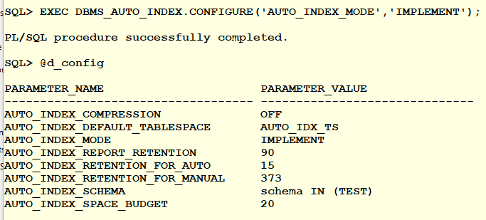
Auto Indexes Enabled for Schema ‘Test’

Slide 30
Review Process of Registration (class_id, canceled)
SELECT a.execution_name, a.table_name,
a.index_name, b.stat_name, a.start_time
FROM dba_auto_index_ind_actions a, dba_auto_index_statistics b
WHERE a.execution_name = b.execution_name
ORDER BY 5,3;
DBA_AUTO_INDEX_VERIFICATIONS

Slide 31
Auto Indexes Created
Shows status of indexes
2 indexes are taking up space

Slide 32
With Compression
EXEC DBMS_AUTO_INDEX.CONFIGURE('AUTO_INDEX_COMPRESSION','ON');

Slide 33
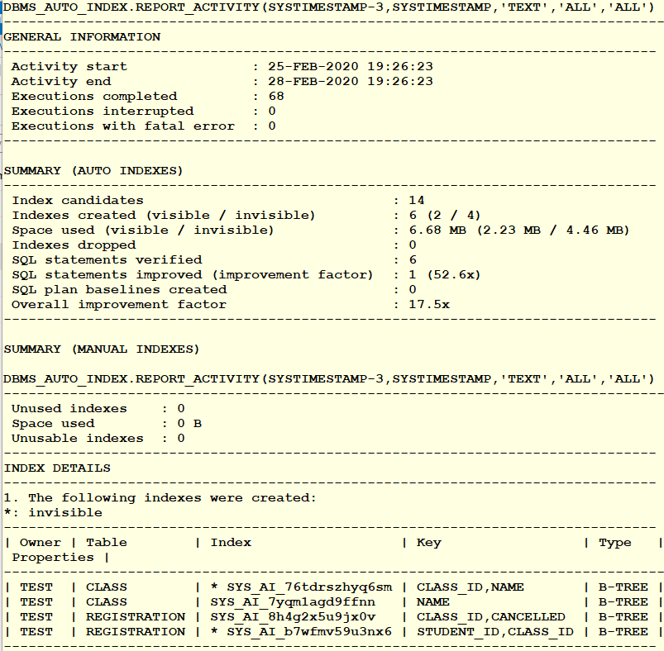
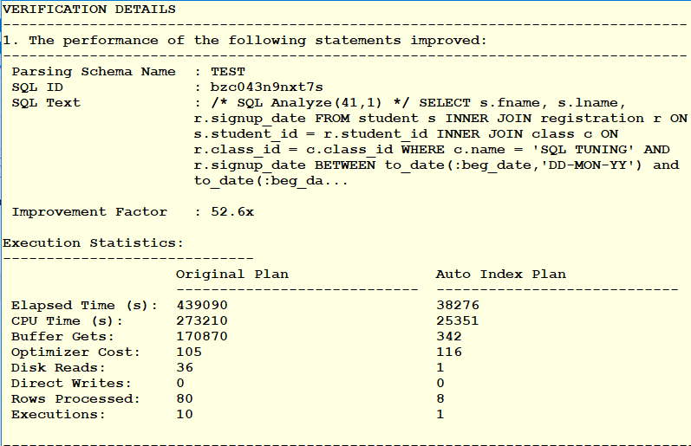
Report_Activity

Slide 34
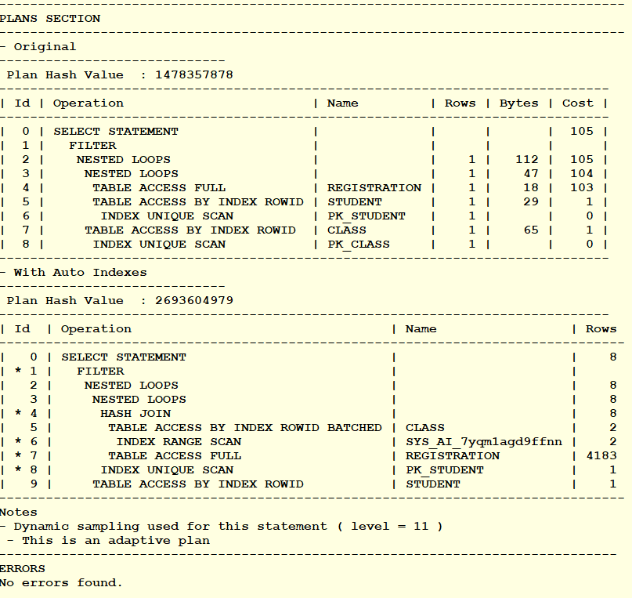
Report_Activity Cont.

Slide 35
Did it measure up?
create index cov_reg on registration(class_id, signup_date, cancelled)
Auto Cost
107
DBA Tuned
Cost
5

Slide 36
Auto Index on Registration

Slide 37
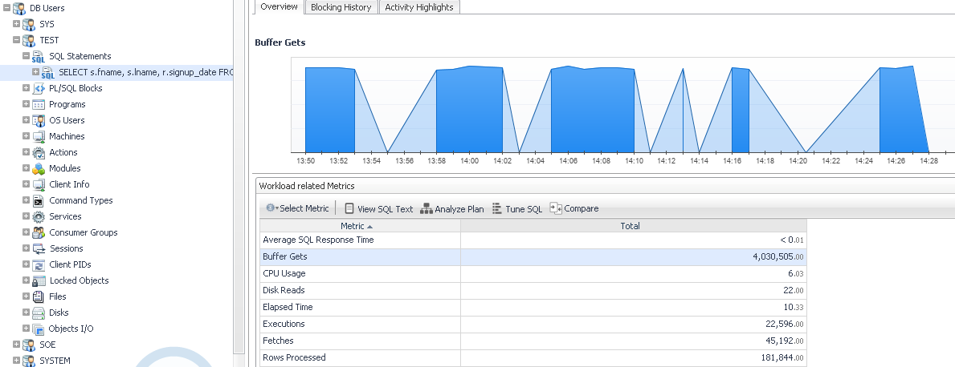
With Auto Index

Slide 38
Auto Index on Registration

Slide 39
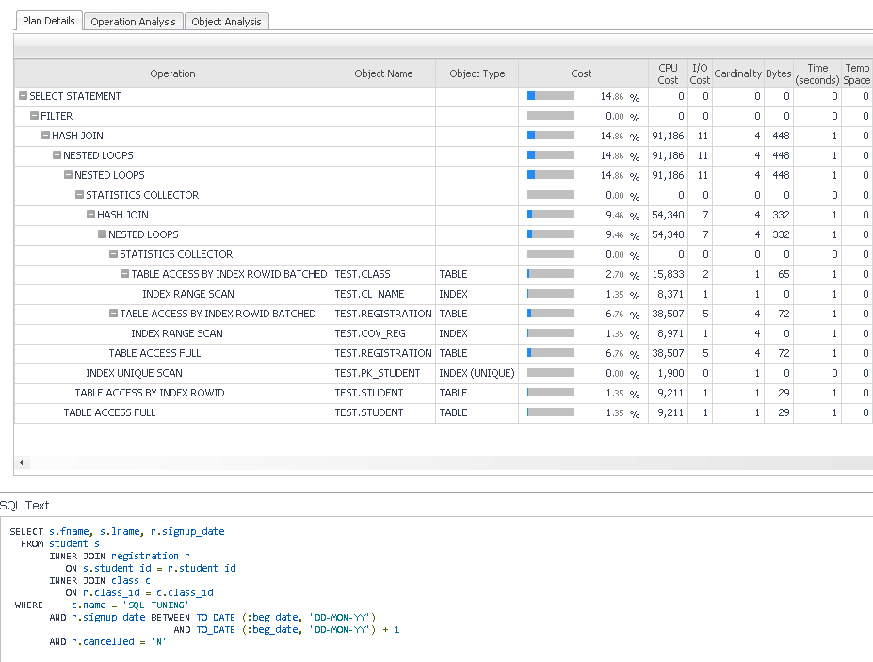
Covered Index on Registration

Slide 40
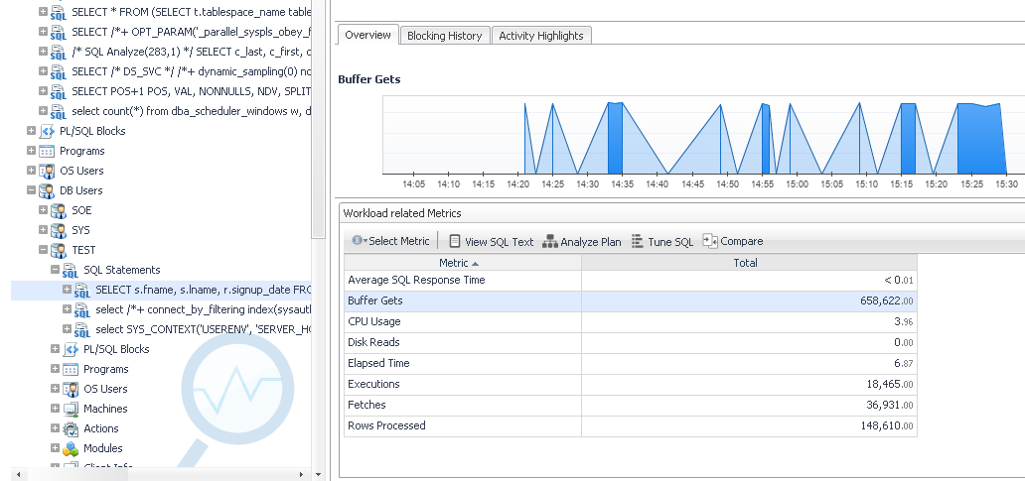
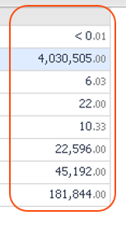
Covered Index on Registration

Slide 41
Covered Index on Registration Wins
Auto Index on Class(name) cost 107
Auto Index on Registration(class_id, canceled) cost 76
DBA Index on Class(name), Registration(class_id, signup_date, cancelled)
Cost 5

Slide 42
Sale Order Query
HammerDB load utility – Slow running query
SELECT c_last, c_first, c_street_1, c_city, c_state, c_zip,
c_phone, o_entry_d, d_name, ol_delivery_d, ol_quantity, ol_amount
FROM order_line, orders, district, customer, stock
WHERE o_id = ol_o_id
AND o_c_id=c_id
AND s_i_id = ol_i_id
AND d_id = ol_d_id
AND ol_w_id = :B2
AND ol_d_id = :B4
AND (ol_o_id < :B3 )
AND ol_o_id >= (:B3 - 20)
AND s_w_id = :B2
AND s_quantity < :B1
AND d_id = :B4
AND c_last like :B5 ;
Order_line 60,461,709
Orders 6,046,215
District 50
Customer 150,000
Stock 500,000

Slide 43
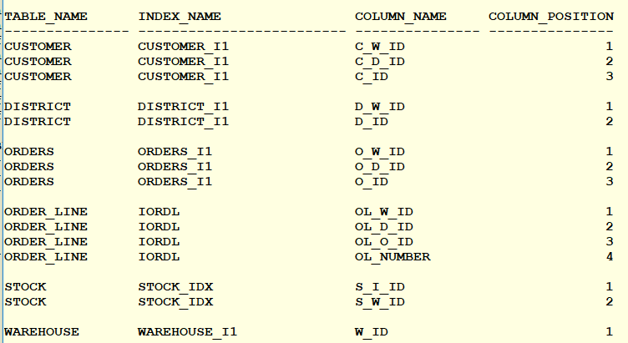
Existing Indexes

Slide 44
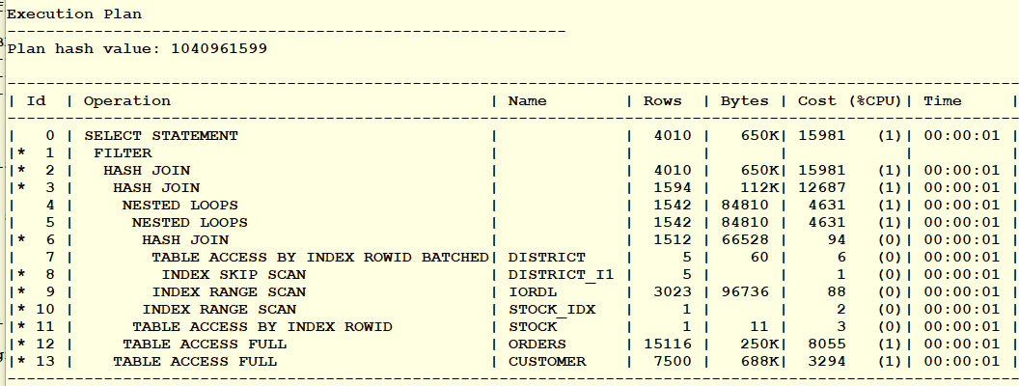
Original Execution Plan

Slide 45
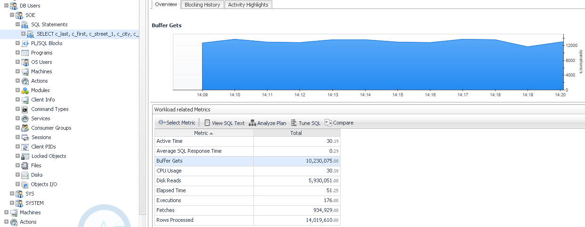
Original Performance

Slide 46
Include SOE Schema for Auto Indexing
SELECT index_name,table_name,
auto,visibility, compression,
segment_created, status
FROM user_indexes
WHERE auto='YES';

Slide 47
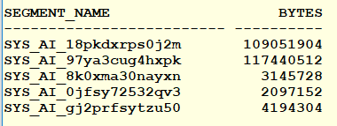
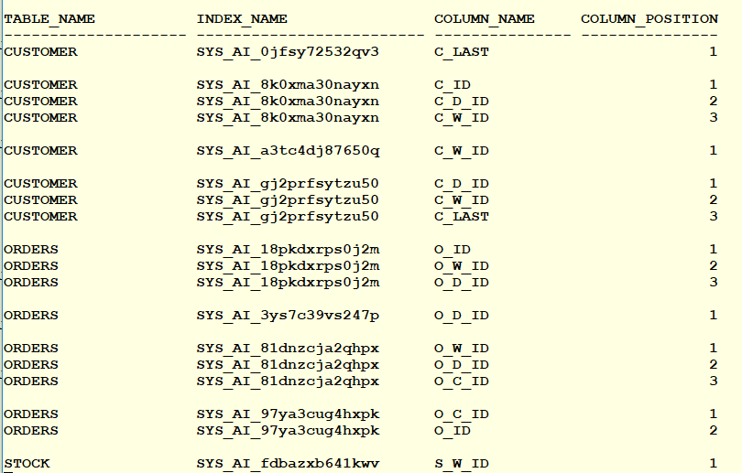
Automatic Indexes
Total Space: 225m
Visible: 9m

Slide 48
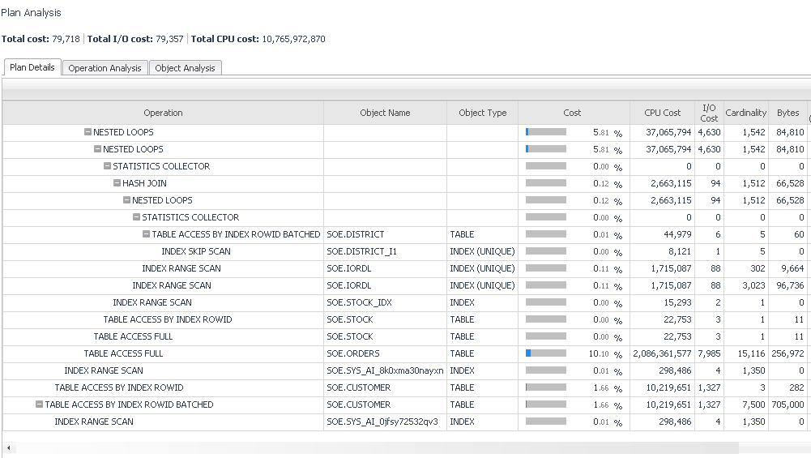
New Execution Plan

Slide 49
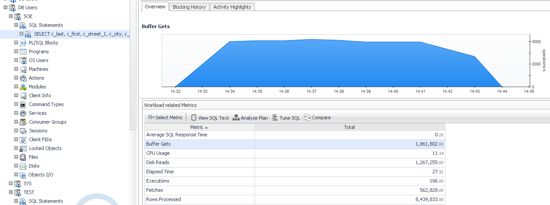
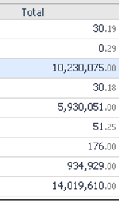
Performance

Slide 50
DBA Fine Tunes the Query
create index orders_i2 on orders(o_id,o_c_id, o_entry_d);

Slide 51
Popular Airline Flights in USA
SELECT
o.carrier, uc.description AS carrier_name
,ao.description AS origin_airport,co.Description AS origin_city
,o.fl_date,o.fl_num,o.tail_num
,ad.description AS destination_airport
,cd.Description AS destination_city ,w.Description Day_of_Week
FROM t_ontime o
INNER JOIN L_UNIQUE_CARRIERS uc ON uc.Code = o.UNIQUE_CARRIER
INNER JOIN L_AIRPORT_ID ao ON ao.Code = o.ORIGIN_AIRPORT_ID
INNER JOIN L_AIRPORT_ID ad ON ad.Code = o.DEST_AIRPORT_ID
INNER JOIN L_CITY_MARKET_ID co ON co.Code = o.ORIGIN_CITY_MARKET_ID
INNER JOIN L_CITY_MARKET_ID cd ON cd.Code = o.DEST_CITY_MARKET_ID
INNER JOIN L_WEEKDAYS w ON w.Code = o.DAY_OF_WEEK
WHERE to_date(fl_date,'YYYY-MM-DD') BETWEEN &beg_date AND &end_date
AND co.Description = &city
AND w.Description = &day_of_week;
L_UNIQUE_CARRIERS: 1620
L_AIRPORT_ID: 6438
L_CITY_MARKET_ID: 5823
L_WEEKDAYS: 8
T_ONTIME: 6784044
US DOT - On-time Performance

Slide 52
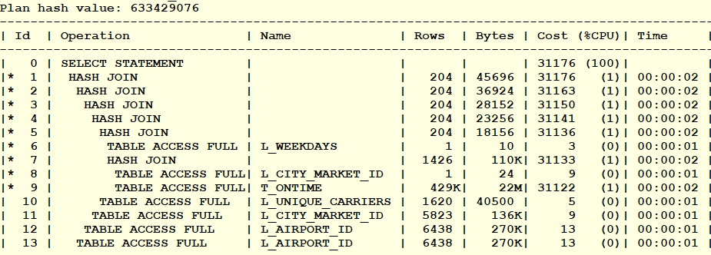
Only Access Path is Full Table Scans
No Original Indexes

Slide 53
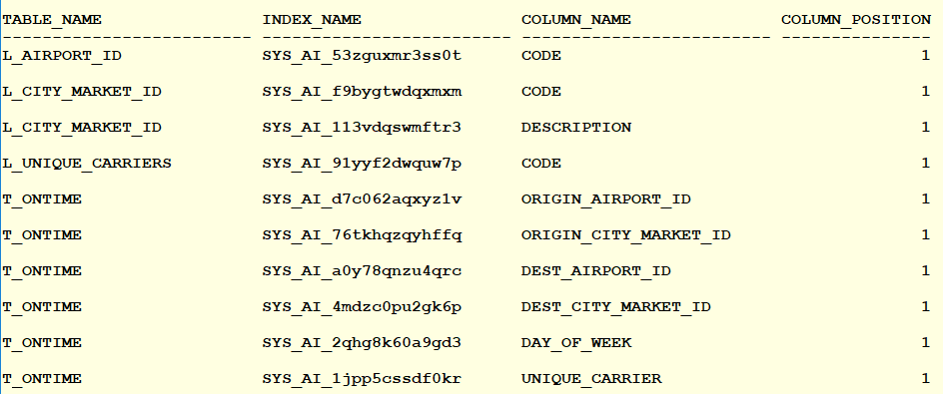
Automatic Indexes
Visible Indexes

Slide 54
No Other Option but Full Table Scans

Slide 55
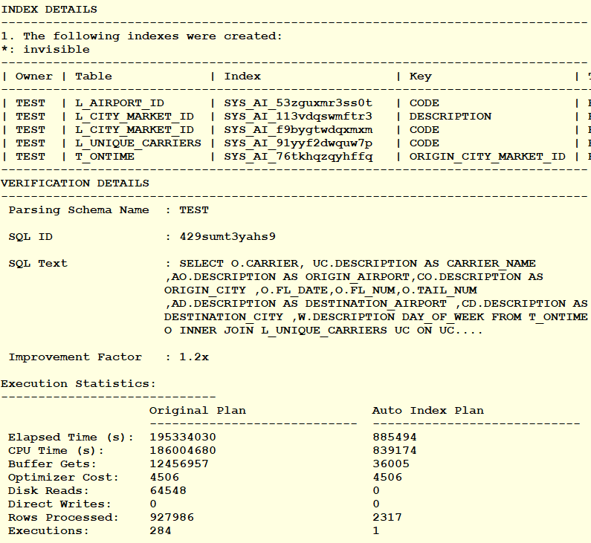
Automatic Index Report
select DBMS_AUTO_INDEX.REPORT_LAST_ACTIVITY('TEXT','ALL','ALL') from dual

Slide 56
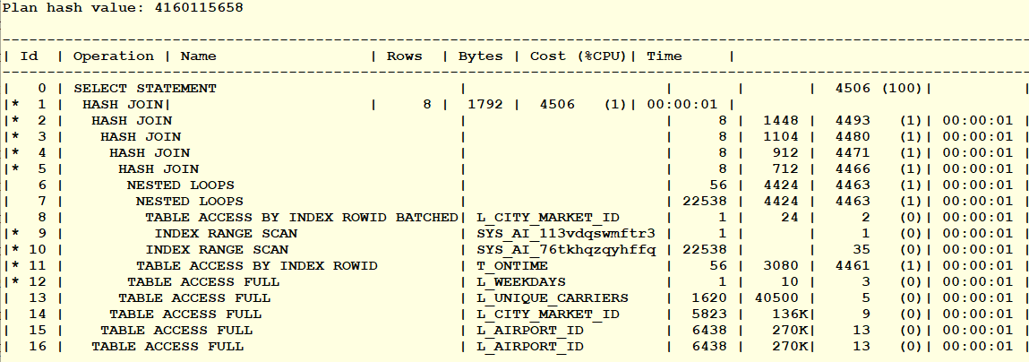
New Plan

Slide 57
Original Performance

Slide 58
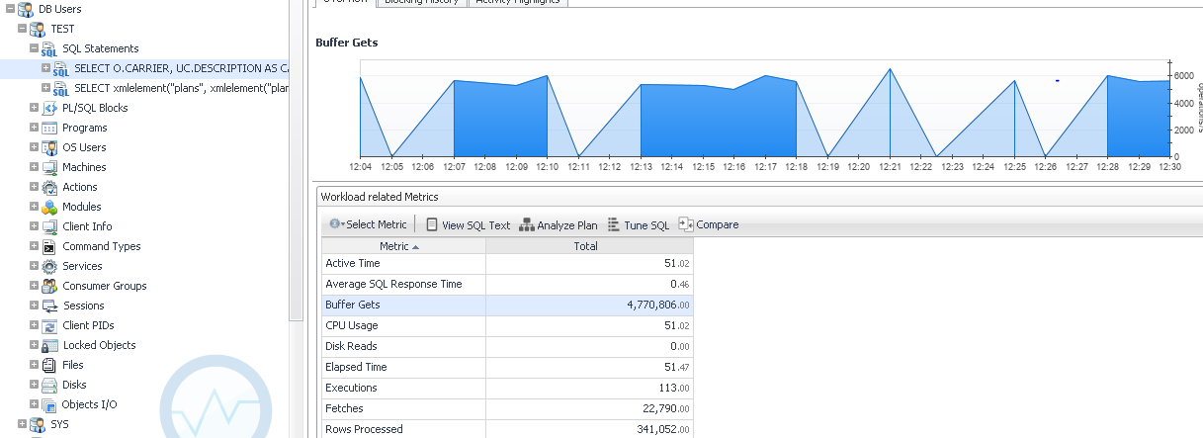
Auto Index Performance

Slide 59
Summary
Automatic Indexing can speed up performance
19c Optimizer has come along way
Beware of just turning it on blindly
Especially in production
Watch out for baselines
Invisible versus Visible
Consider using in development / test
Be cautious using in production
Control at schema level
Turn on compression for space savings

Slide 60
Save The DATE
ASCEND CONFERENCE 2022
June 12-15, 2022
the Aria in Las Vegas, NV
https://ascendusersconference.com
MOUS 2022
October 26, 2022
Schoolcraft College - VisTaTech Center,
18600 Haggerty Rd, Livonia, MI
https://www.mous.us
THANK YOU
www.mous.us

Slide 61
SURVEYS
Session Surveys
Please complete the session survey for this session using the Zoom session survey link.
The survey link will be provided via email once the webinar is closed.
THANK YOU
WWW.MOUS.US

