Slide 1
MICHIGAN ORACLE USERS SUMMIT 2021
Can an old Oracle expert tune queries in SQL Server?
Presenter Name: Janis Griffin
Presenter Title: Senior Systems Consultant
COMPANY: Quest Software
Monday October 25 – Thursday October 28, 2021
Virtual event

Slide 2
Who Am I
Senior Sales Engineer / DBA
Janis.Griffin@Quest.com
Twitter® - @DoBoutAnything
Current – 30+ Years in Oracle®, DB2®, ASE, SQL Server®, MySQL®
DBA and Developer
Specialize in Performance Tuning
Review Database Performance for Customers Common Question – How do I tune it?
Notes:
A little bit about myself

Slide 3
Agenda
Challenges of Tuning
How to Review the Execution Plan
Evolution of SQL Server Query Optimizer
Understand the features
Several Case Studies
Notes:
Here is the agenda for today. First we are going to talk about the challenges of tuning and then we’ll jump right into execution plans, I’ll talk about all the operators and also touch on the evolution of the sql server query optimizer – understand all the features. And then I’ll go through several case studies to bring it on home.

Slide 4
Challenges of Tuning
SQL Tuning is Hard
Who should tune – DBA or Developer
Which SQL to tune
Requires Expertise in Many Areas
Technical – Plan, Data Access, SQL Design
Business – What is the Purpose of SQL?
Tuning Takes Time
Large Number of SQL Statements
Each Statement is Different
Low Priority in Some Companies
Vendor Applications
Focus on Hardware or System Issues
Never Ending
Notes:
Lets face it, tuning can be hard. It’s even hard to know who should tune the query. Some think the DBA should tune but they may not know the application and are busy just keeping the lights on. You’d think the developer who wrote the application should be able to tune however, they might be java programmers who use 3rd party sql generators. Also tuning requires expertise in many areas. You need to know how to read an execution plan and identify which data access paths to use. I also think you need to know how to write good sql. It’s also important to know the the business purpose for the sql. Years ago… Also tuning takes time. Large number of sql statements and no cookie cutter approach. Also, some companies think tuning is busy work and would rather throw hardware at it problem but that can be an expensive fix that may not last very long. Also tuning can be never ending… which could be a good thing if you get good at it.

Slide 5
Review the Execution Plan
SET SHOWPLAN_XML { ON | OFF }
SQL Server Management Studio (SSMS)
Estimated Execution Plan - can be wrong for many reasons
SET SHOWPLAN_XML { ON | OFF }
Actual Execution Plan – must execute query
Can be dangerous in production / Wrong in test
SET STATISTICS XML { ON | OFF }
Live Query Statistics (2014+)
SQL Server Profiler Tracing / Extended Events
Performance: Execution Plan (2000)
Showplan XML (2005+)
Works when you know a problem will occur
DM_EXEC_QUERY_PLAN
Cached execution plan of executed query
Notes:
It’s important to review the execution plan. Maangement Studio gives you various was to get the execution plan. You can get an estimated plan which can be wrong for many reasons. You can get the actual plan which is more accurate because it has to execute the query first – which can be dangerous in production. Or if you are on 2014 or above, you can get live query stats in which it doesn’t have to complete the execution of the query first.
You can also use sql server profiler tracing or extended events. But you have to set that up so you have to know when the problem will occur in order to capture it.
Finally, you can get the cached execution plan of an executed query from the table_value function - DM_EXEC_QUERY_PLAN

Slide 6
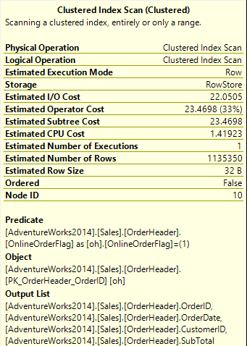
Examine the Execution Plan
Find Expensive Operators
Examine CPU / IO costs, row counts
Look for full table or clustered index scans
Review the Predicate Information
Know how parameters are being interpreted
Review the data types / Implicit conversions?
Know which step filtering predicate is applied
Review Join Methods
Nested Loops join: Usually efficient for smaller data sets
Merge Join: Efficient for larger data sets.
Hash Match join: Useful on very large data sets (DW)
Notes:
It’s important to examine the execution plan. You’ll want to find the expensive operators. Examine the cpu and IO costs and row counts. I always look for full table or clustered index scans – to make sure it warranted or not.
I review the predicate information looking at the data types to see if there are any implicit conversions going on. I also like to know which step the filtering predicate is happening – the earlier the better. I also review the join methods.

Slide 7
Execution Plan Operators
Table Scan
Heap – data rows are not stored in any order
Clustered Index Scan
Data rows are stored in the index at the leaf level
Rows are ordered by clustered index key
Clustered Index Seek
Uses clustered index key to get exact match
Non-clustered Index Seek
Uses secondary index to find the clustered index key or RID
Notes:
I’m going set through many of the operators now as it’s important to know what they are doing and why the optimizer chose to use them. Table scan is a heap where data rows aren’t sorted and are not stored in any order. Unless it’s a very small table, you would probably never want a heap in your database. Clustered index scan is where the data rows are stored at the leaf level of the index. Rows are order by the clustered index key.

Slide 8
Execution Plan Operators – Cont.
RID Lookup
Non-clustered index contains the RID of a heap at the leaf level of the index
Uses RID to retrieve data rows from heap
Key Lookup
Non-clustered index contains the clustered key at the leaf level
Sort Operator
As data is retrieved, it’s sorted by the columns in the ORDER BY
Aggregate Operator
Used to calculate aggregate expressions such as MIN & MAX

Slide 9
Execution Plan Operators – Cont.
Compute Scalar
Is used to calculate a new value from an existing row
For example, a conversion or concatenation (select name + ‘@gmail.com’)
Performs a scalar computation operation to get the computed value
Concatenation Operation
Take one or more sets of data and returns all (UNION ALL)
Assert Operator
Used to verify that inserted values meet predefined CHECK or FK constraints

Slide 10
Execution Plan Operators – Cont.
Hash Match Join
During a join, the optimizer divides the data into equally sized buckets
Uses an algorithm, Hashing Function to quickly access the data
Hash Match Aggregate
Used for large tables that aren’t sorted using an index
Creates a hash table in memory, calculates a hash value for each row
Merge Join
Used when 2 data sets are sorted according to the join predicate
It will read from 2 data sets at the same time, compare it, then return it

Slide 11
Execution Plan Operators – Cont.
Nested Loops Join
Is used to join the outer input, by executing it one time
With the inner input
The optimizer decides to use NLJs when the outer input table is small
And the inner input table has an index created on the join predicate key
Segment Operator
Used to divide the input data into different groups based on their values
Then it partitions the data into groups depending on their values

Slide 12
Execution Plan Operators – Cont.
Table Spool Operator (Lazy Spool)
Is used to build a temporary table in TempDB and fill it in a lazy manner
It fills the table by reading & storing the data only when the rows
Are required by the parent operator
Merge Interval Operator
Used to perform a DISTINCT query by identifying the overlapping intervals
Then merges it to generate a non-overlapping intervals with no duplicates
Filter Operator
Used to check the input data that satisfies the predicate expression (often used with HAVING clause)

Slide 13
Execution Plan Operators – Cont.
Online Index Insert
When creating an index, you can create or alter an index online
This operation is used for online index manipulation
Sequence Project Operator
Closest to the Segment operator, can be seen when using
ROW_NUMBER(), RANK(), or DENSE_RANK()
Sequence Project Operator is used while classifying data into groups
It adds 1 to the row count column while the Segment operator is still working

Slide 14
Execution Plan Operators – Cont.
Eager Spool Operator
Used to take all the records passed to it from another operator
Reads all the data at one time, blocking any access to the data during that one shot read and stores it in a temp table
Parallelism Operator
SQL Server will manage to execute a query using a parallel plan to speed up
Expensive queries
Maximum Degree of Parallelism can not be set to 1
Query cost exceeds the Cost Threshold for Parallelism

Slide 15
Execution Plans Help You Tune
Identify Common Mistakes
Using functions on filtering columns
In WHERE, ON & HAVING clause
Nested views
One view calling or joining to other views
Implicit conversions of column data types
Use of cursors or row by row processing
Common Warning Signs
Warnings
Fat Pipes
Extra Operators and/or Costly Operators
Table or Index Scans
Notes:
Show examples
1.The INDEX SCAN on the Location.Name column – there’s an index on that column a SEEK is expected - culrit: LTRIM(RTRIM(l.Name)), in the WHERE clause
2.The FAT PIPE coming out of the Clustered Index Scan on the ProductInventory table — in this example, it’s processing over 1000 rows at this stage, and eventually only returning 9 rows. — culprit: missing index on the column.
3.The HASH MATCH join — for the number of rows returned I’m expecting a NESTED LOOPS join — culprit: bad or missing indexes.
You can identify common mistakes. For example, using functions on filtering column that indexed in a where on or having clause. Nested views, implicit conversions of column data types. Use of cursors or row by work processing. Look for common warning signs. Warnings fat pipes extra operators, table or index scans

Slide 16
Execution Plans Help You Tune
Missing or Poor Indexing
Optimizer may suggest adding an index
Note! These may not be correct, so test, test, test
Nested Views
Optimizer tries to transform or simplify the query
If the query is too complex, the optimizer runs out of time
Stops assigning costs & just assumes 1 row returned at each step
Parameter Sniffing
Problems Outside of Execution Plans
Missing or stale statistics
Database misconfiguration (i.e. default parallelism settings)
No database constraints
Notes:
Show example of nested views:
Parameter sniffing:
There are other possible causes of a mismatch between estimated and actual number of rows returned. The optimizer can sometimes create and reuse a plan for a stored procedure, function or parameterized query based on an atypical ‘sniffed’ parameter value. This results in an estimated number of rows that is very non-representative of the row count that will result from future executions, and leads to intermittent performance issues. If you suspect this is happening, compare execution plans for when the query is running well with those for when it’s running badly in order to identify which parameter value is causing the poorly performing plan. There are several possible solutions. Perhaps the most common is to use the OPTIMZE FOR query hint, within the procedure or function, to instruct the optimizer to create a plan optimal for a ‘typical’ parameter value. For more details, see the previously-referenced Troubleshooting SQL Server: A Guide for the Accidental DBA.

Slide 17
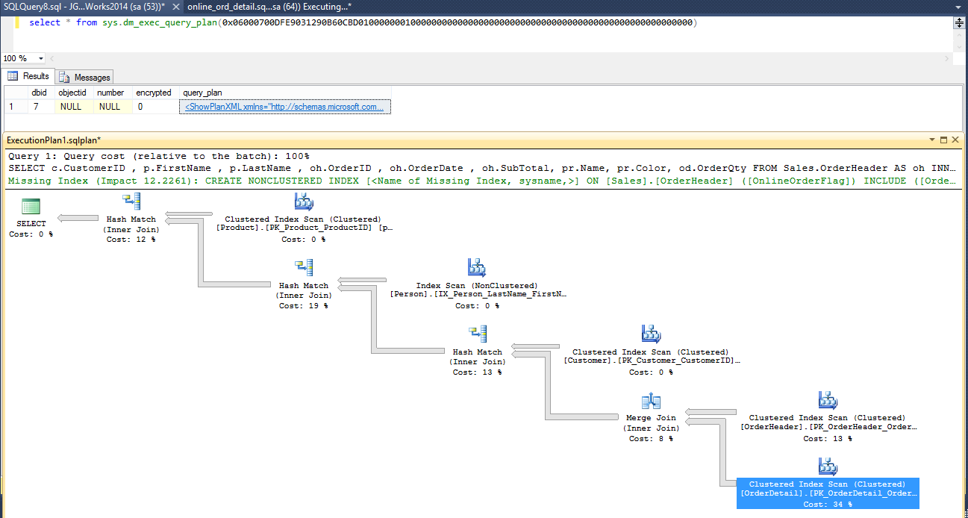
DM_EXEC_QUERY_PLAN Example

Slide 18
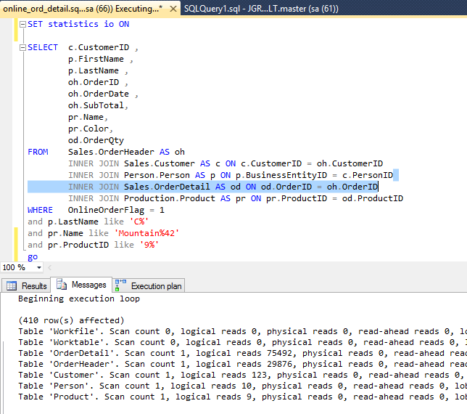
Review Logical IO

Slide 19
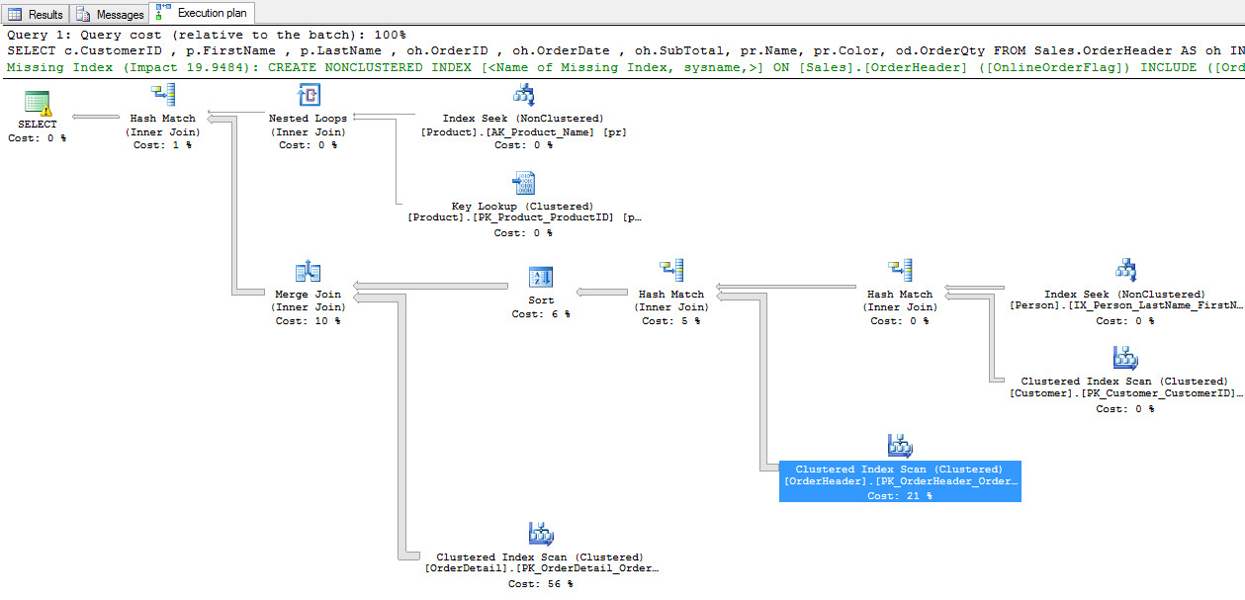
Execution Plan
CREATE NONCLUSTERED INDEX
<Name of Missing Index, sysname
ON Sales.OrderHeader(OnlineOrderFlag)
INCLUDE
(OrderID,OrderDate,CustomerID,SubTotal)

Slide 20
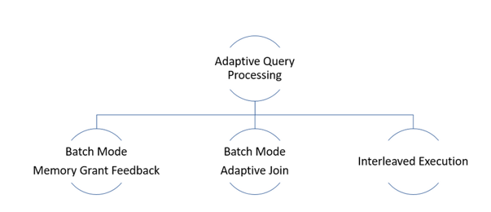
Optimizer – What Features Are Enabled
Batch Mode Memory Grant Feedback
Recalculates the actual memory required for query
Updates the grant value for the cached plan
Reducing excessive memory grants
Must be > 1 MB & must use > 2 times actual size needed
Fixing underestimated memory grants
Turns it off if query parameter-sensitive
Batch Mode Adaptive Join
Defers choice of Hash Join or Nested Loops Join
After first input has been scanned
Figures out a row count threshold
< threshold, uses nested loops join
>= threshold, uses hash join
See AdaptiveThresholdRows property
Interleaved Execution
Revises cardinality estimates for Multi-Statement Table Value Functions
MSTVFs had a fixed cardinality guess of 100 in earlier versions

Slide 21
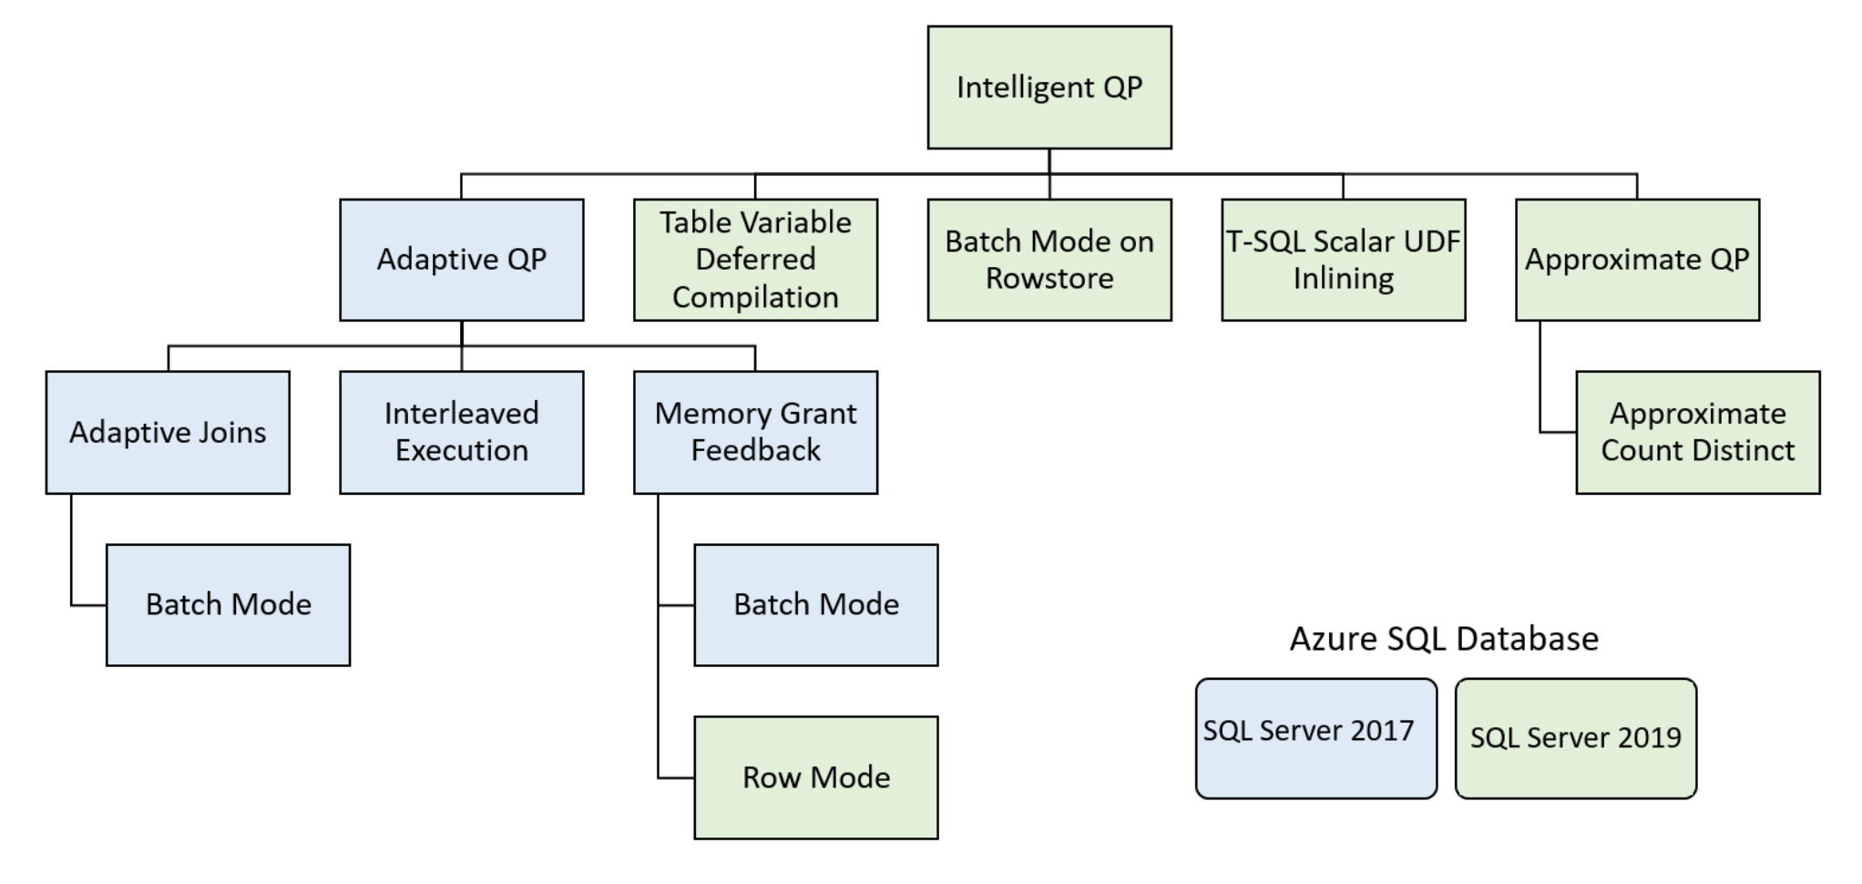
Intelligent Query Processing (2019)
Improves Performance & Scalability without changes to application

Slide 22
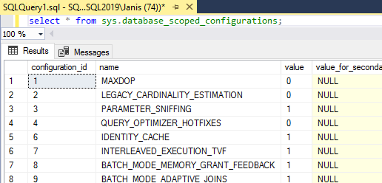
Check Compatibility Level
ALTER DATABASE database_name SET COMPATIBILITY_LEVEL = 150; - 2019
Adaptive Joins (2017, 140)
Dynamically changes join method during runtime based on actual input rows
Nested Loops vs Hash Joins
Now works on rowstore tables
2017, columnstore indexes
declare @territory int = 0;
select sum(oh.SubTotal)
from Sales.SalesOrderHeader oh
join Sales.SalesOrderDetail od
on oh.SalesOrderID = od.SalesOrderID
where oh.TerritoryID=@territory
option(optimize for (@Territory = 0));

Slide 23
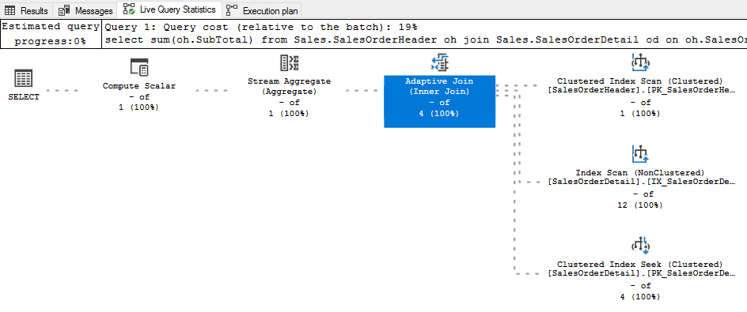
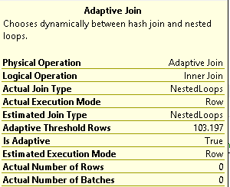
Adaptive Joins – Cont.
@territory = 0

Slide 24
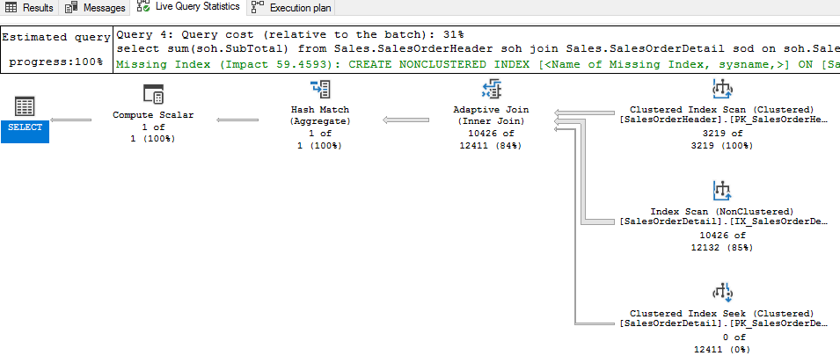
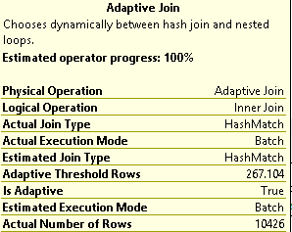
Adaptive Joins – Cont.
@territory = 1
Notes:
In order to use most of these features, you must have the compatibility mode set to 150. For adaptive joins which was really in 2017 release, you can set it a 140.
Adaptive joins basically changes the join method on the fly by sampling the dataset at runtime to get a threshold of when it should use nested loops or hash joins. In the example here, I ran a query against sales order header and sales order detail, returning product information for a certain customer. As you can see the adaptive join step which decided to do nested loops because of the ADAPTIVE threshold rows of 44.

Slide 25
Case Study Who registered yesterday for SQL Tuning Class?
1

Slide 26
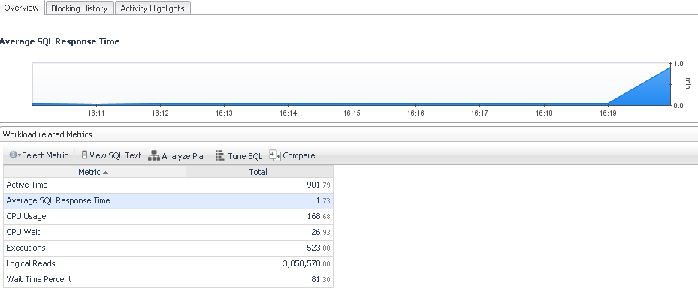
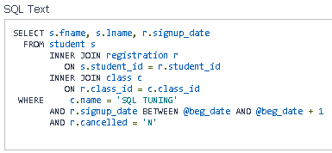
Who registered yesterday for SQL Tuning
SELECT s.fname, s.lname, r.signup_date
FROM student s
INNER JOIN registration r ON s.student_id = r.student_id
INNER JOIN class c ON r.class_id = c.class_id
WHERE c.name = 'SQL TUNING'
AND r.signup_date BETWEEN :beg_date AND :beg_date +1
AND r.cancelled = ‘N‘
Execution Stats –3,050,570 Logical Reads
Execution Time – Approx. 2 seconds
Wait Type – ASYNC_NETWORK_IO

Slide 27
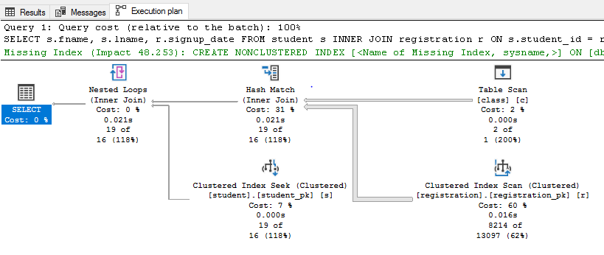
Execution Plan

Slide 28
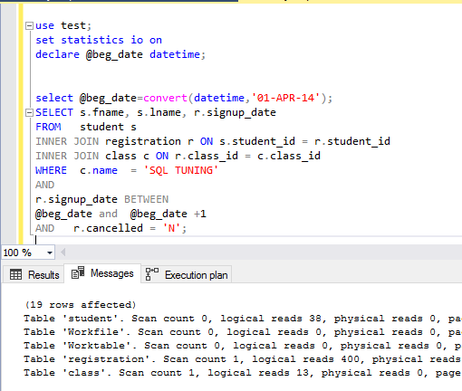
Review Logical IO

Slide 29
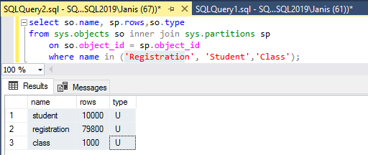
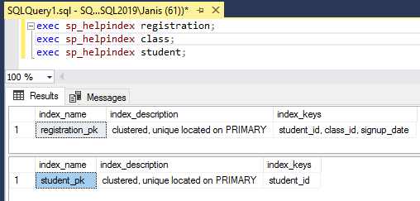
Review Tables & Indexes
No Index on Class?

Slide 30
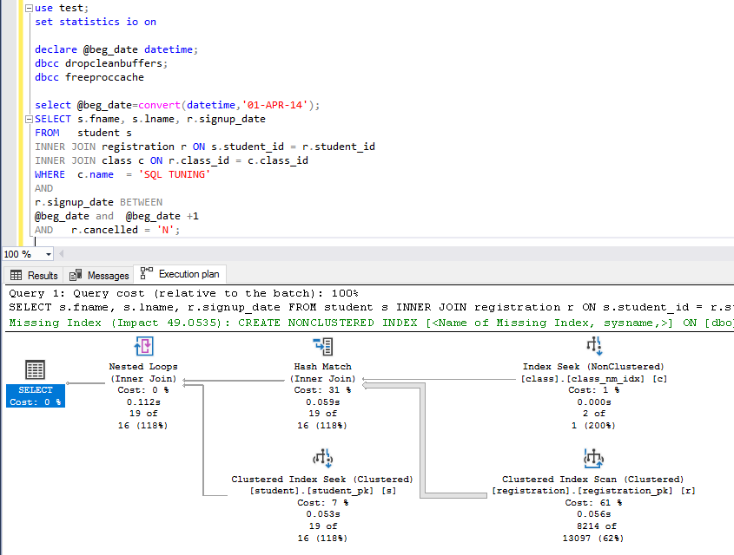
Add Indexes on Class
CREATE UNIQUE CLUSTERED INDEX class_pk ON class(class_id);
CREATE NONCLUSTERED INDEX class_nm_idx ON class(name);
Missing Index
create nonclustered index reg_alt on
Registration (cancelled,signup_date);
Logical Reads:
Class: 2 (13)
Registration: 400 (400)
Student: 38 (38)
Why is the clustered primary key doing a scan?

Slide 31
Registration Index
Starts with student_id, not class_id

Slide 32
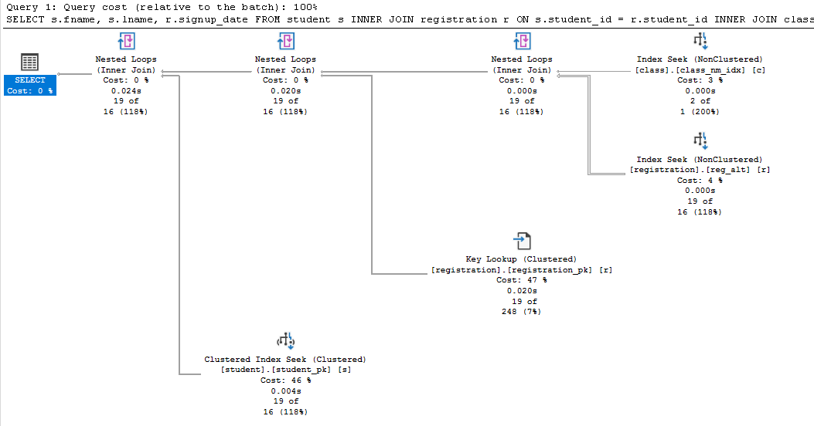
Add Index on Registration (Class_Id)
create nonclustered index REG_ALT on registration(class_id);
Logical Reads:
Class: 2
Registration: 63 (400)
Student: 38

Slide 33
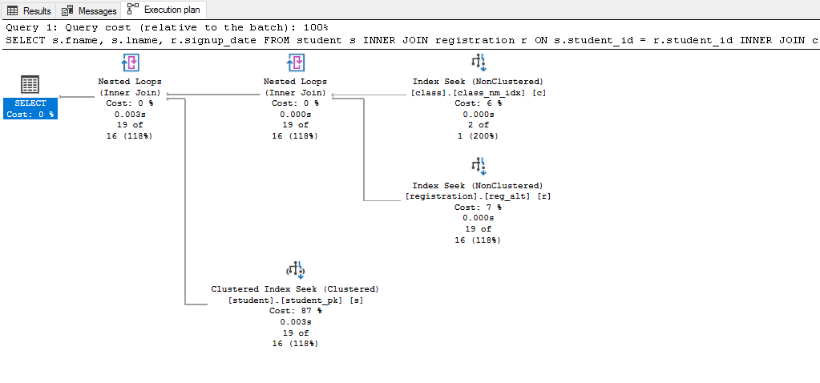
Is it the Best index?
create nonclustered index REG_ALT on registration(class_id, signup_date, cancelled);
Logical Reads:
Class: 2
Registration: 6 (63)
Student: 38

Slide 34
Case Study Get Customer Orders
2

Slide 35
Customer Orders
SELECT c.CustomerID ,
p.FirstName ,
p.LastName ,
oh.OrderID ,
oh.OrderDate ,
oh.SubTotal,
pr.Name,
pr.Color,
od.OrderQty
FROM Sales.OrderHeader AS oh
INNER JOIN Sales.Customer AS c ON c.CustomerID = oh.CustomerID
INNER JOIN Person.Person AS p ON p.BusinessEntityID = c.PersonID
INNER JOIN Sales.OrderDetail AS od ON od.OrderID = oh.OrderID
INNER JOIN Production.Product AS pr ON pr.ProductID = od.ProductID
WHERE oh.OnlineOrderFlag = 1
and p.LastName like 'C%'
and pr.Name like 'Mountain%42'
and pr.ProductID like '9%'
Joins
Filtering Predicates

Slide 36
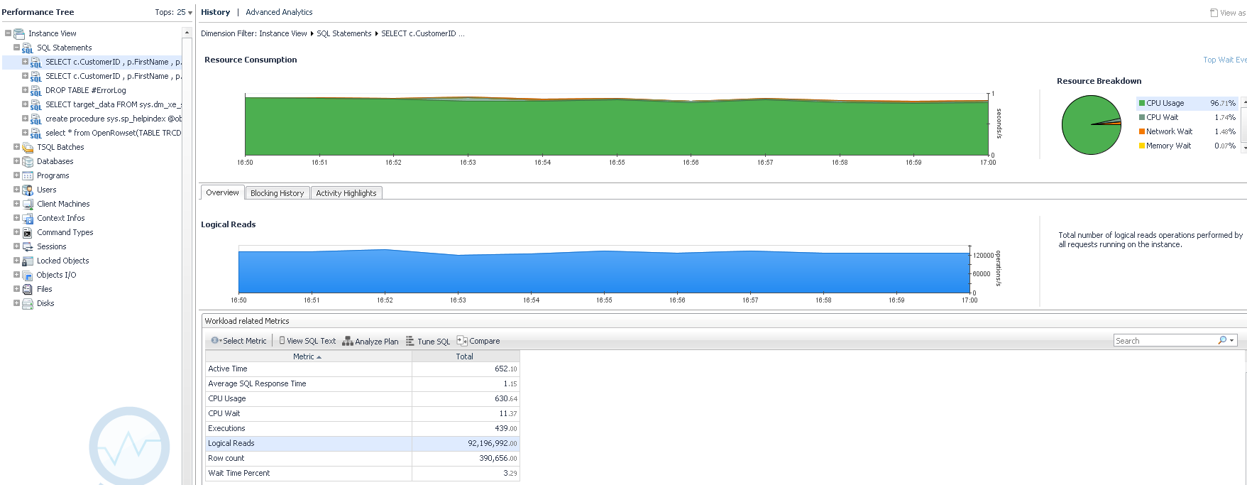
Top Query / Get Baselines Metrics

Slide 37
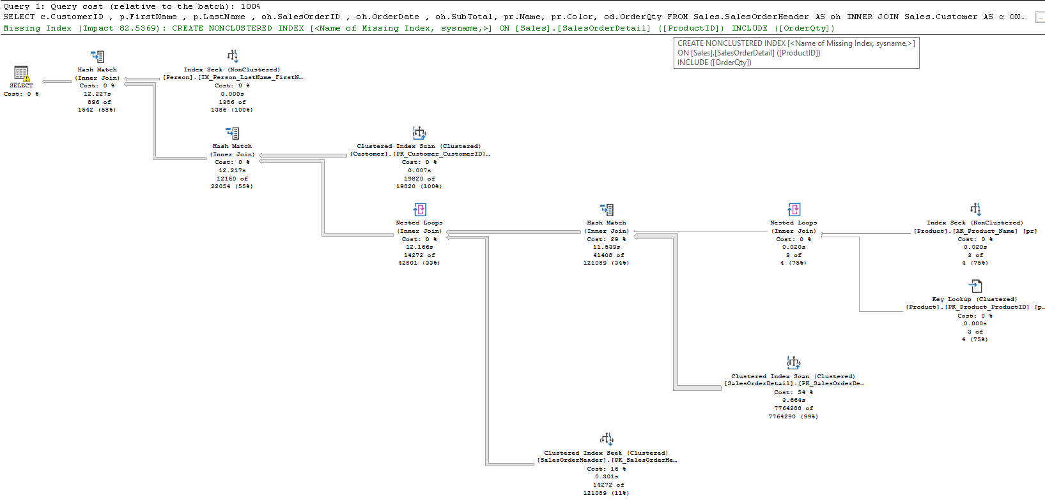
Execution Plan

Slide 38
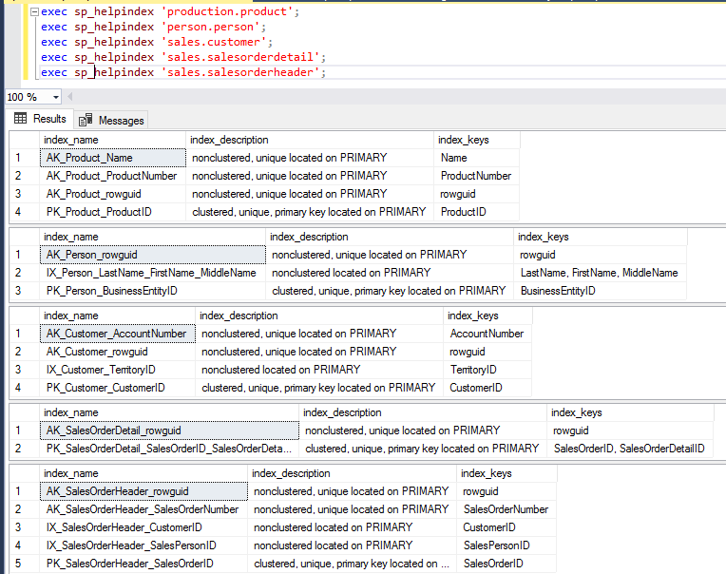
Review the Indexes
Why isn’t the clustered primary key being used?

Slide 39
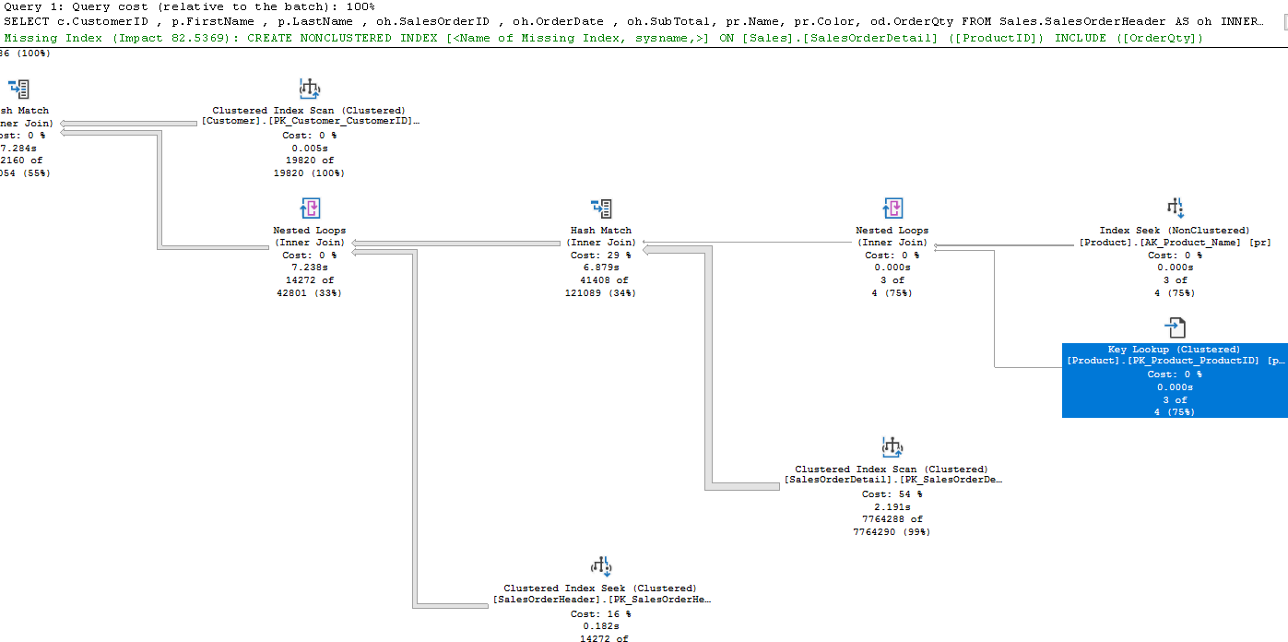
Why the Key Lookup?

Slide 40
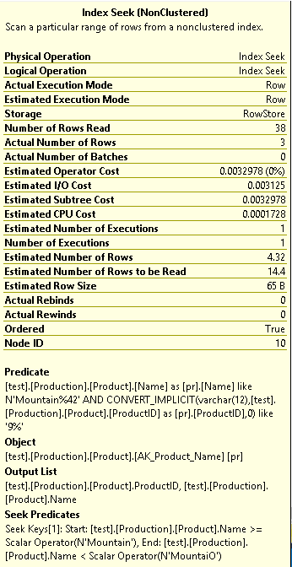
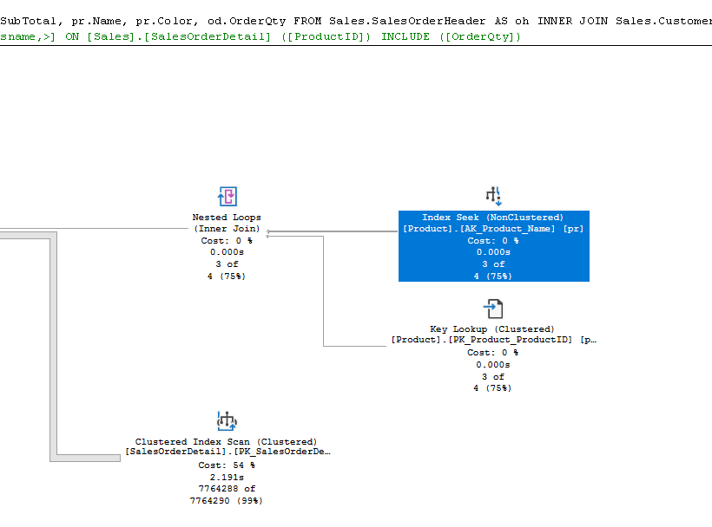
Implicit Conversion

Slide 41
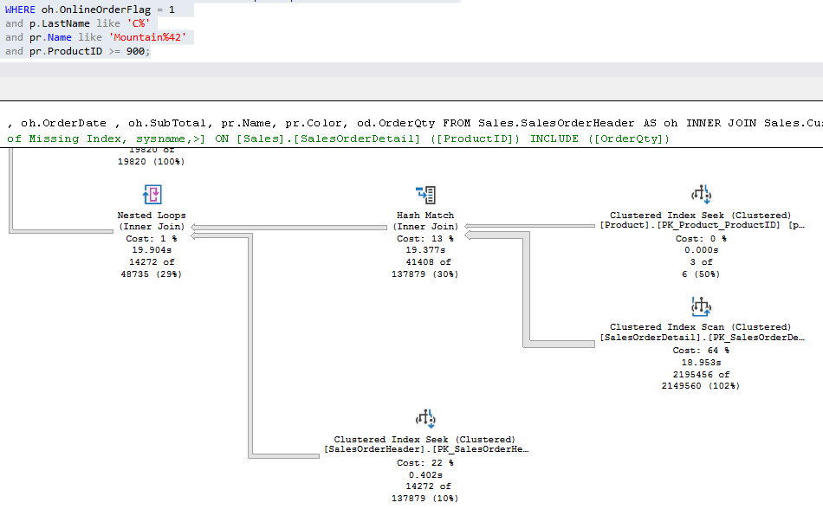
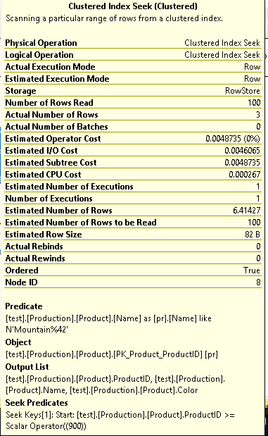
Try to Fix the Implicit Conversion
ID range : 1-999

Slide 42
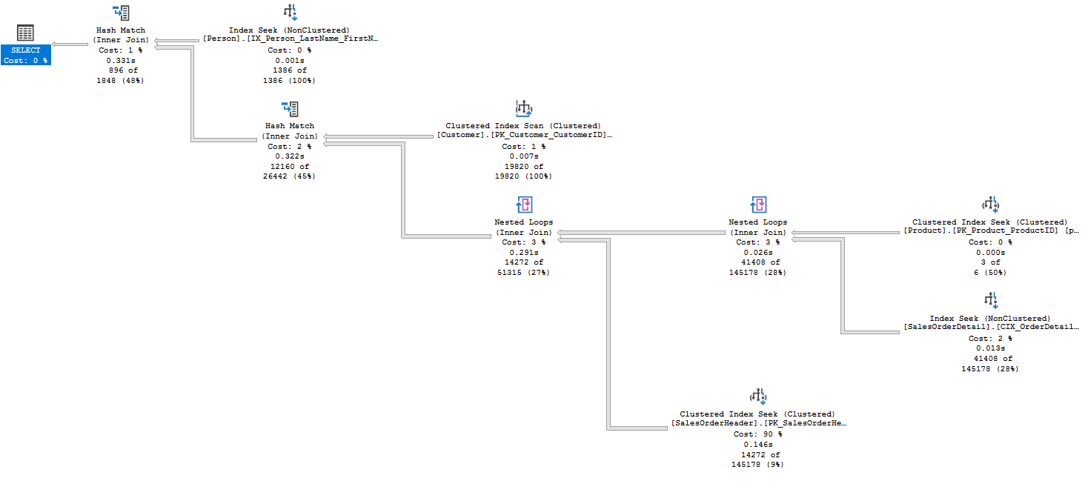
Add Covering Index on OrderDetail
CREATE NONCLUSTERED INDEX CIX_OrderDetail_ProductID
ON Sales.SalesOrderDetail(ProductID)
INCLUDE (OrderID,OrderQty)

Slide 43
Still High Cost?

Slide 44
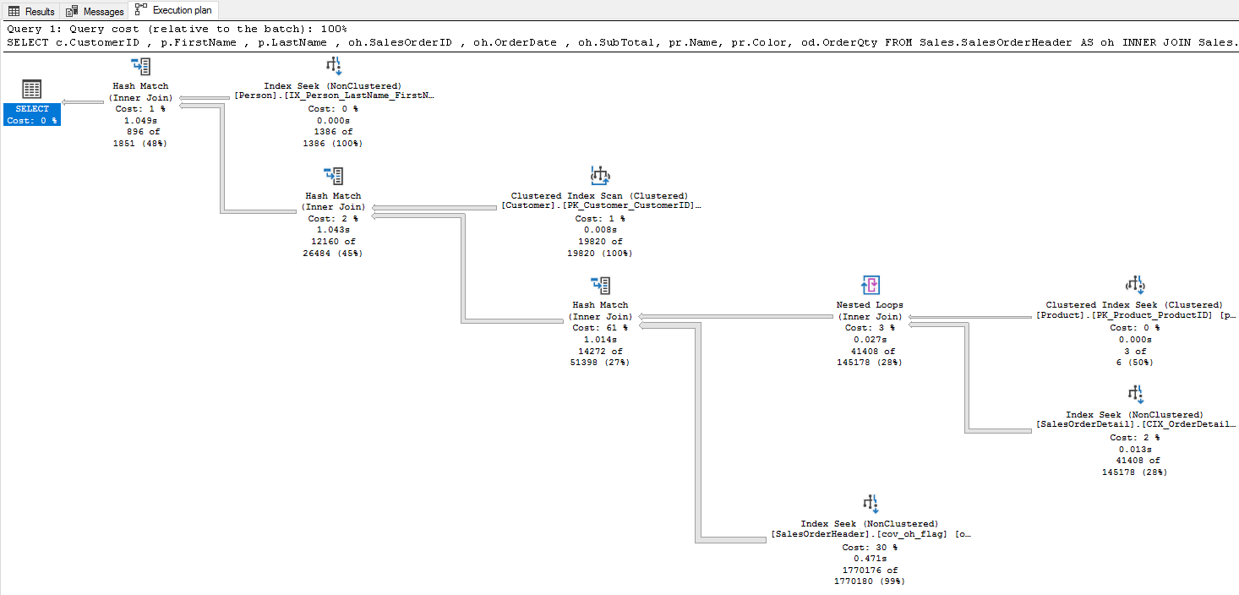
Add Covering Index on OrderHeader

Slide 45
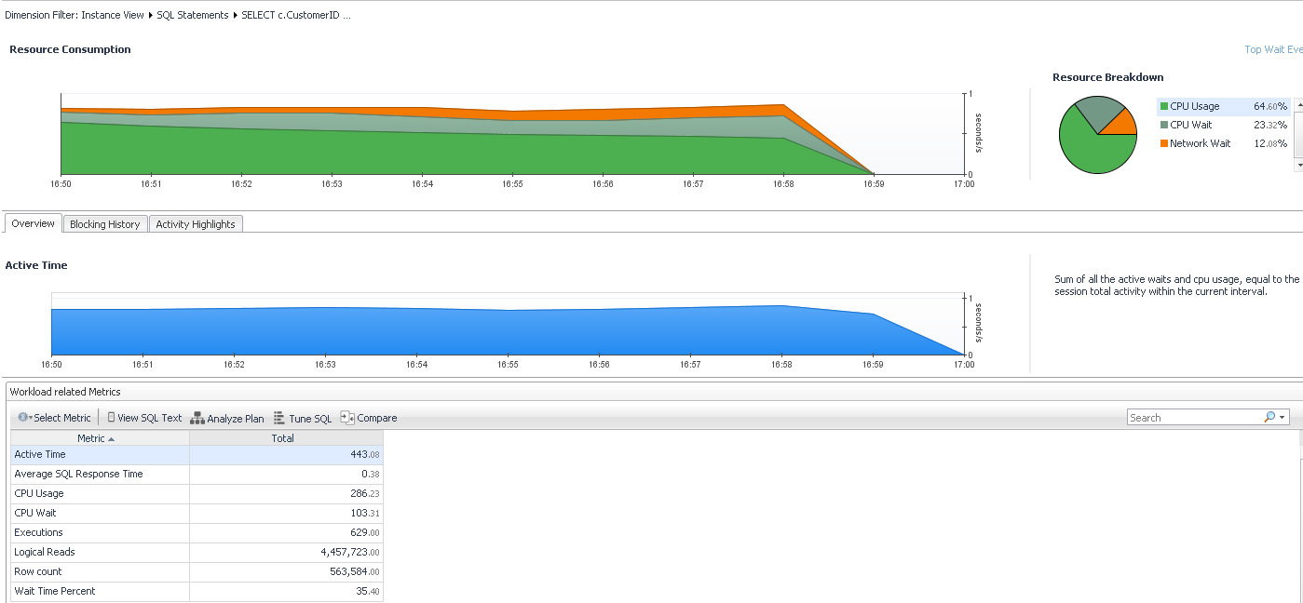
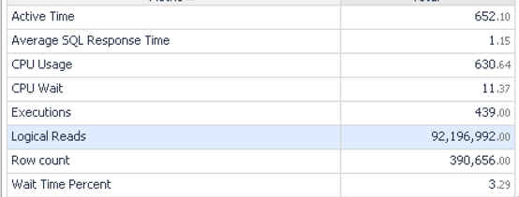
Did We Improve It?
Avg Response: 1.15s to .38ms
Execs: 439 to 629
Logical Reads: 92m to 4.5m
Throughput: 1.5x greater
Before
© 2018 SolarWinds Worldwide, LLC. All rights reserved.

Slide 46
Case Study Flights by City & Day of Week
3

Slide 47
Flights by City & Day of Week
CREATE PROCEDURE get_city_day_flights
@beg_date DATETIME, @end_date DATETIME, @city VARCHAR(50), @day_of_week VARCHAR(10)
AS
SELECT
o.carrier, uc.description AS carrier_name, o.fl_date,o.fl_num,o.tail_num
,ao.description AS origin_airport,co.Description AS origin_city
,ad.description AS destination_airport
,cd.Description AS destination_city ,w.Description Day_of_Wed
FROM t_ontime_2015 o
INNER JOIN L_UNIQUE_CARRIERS AS uc ON uc.Code = o.UNIQUE_CARRIER
INNER JOIN L_AIRPORT_ID AS ao ON ao.Code = o.ORIGIN_AIRPORT_ID
INNER JOIN L_AIRPORT_ID AS ad ON ad.Code = o.DEST_AIRPORT_ID
INNER JOIN L_CITY_MARKET_ID AS co ON co.Code = o.ORIGIN_CITY_MARKET_ID
INNER JOIN L_CITY_MARKET_ID AS cd ON cd.Code = o.DEST_CITY_MARKET_ID
INNER JOIN L_WEEKDAYS AS w ON w.Code = o.DAY_OF_WEEK
WHERE fl_date BETWEEN @beg_date AND @end_date
AND co.Description = @city
AND w.Description = @day_of_week

Slide 48
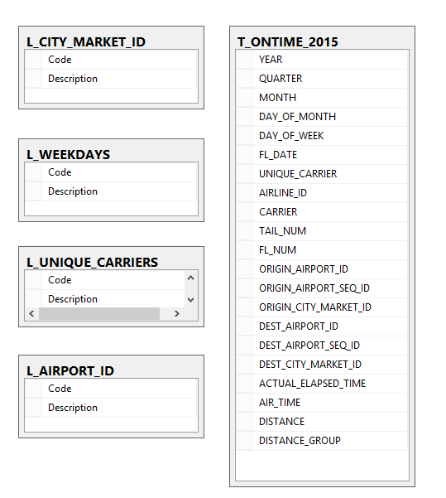
Case Study
US DOT - On-time Performance

Slide 49
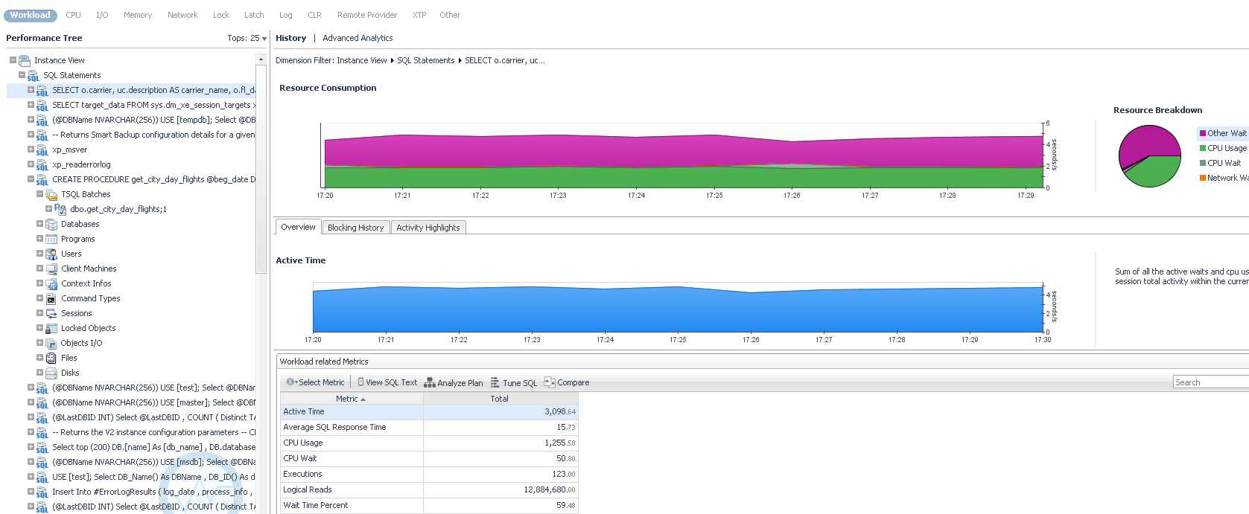
Query spending the most time (WTA)

Slide 50
Get & Examine the Execution Plan

Slide 51
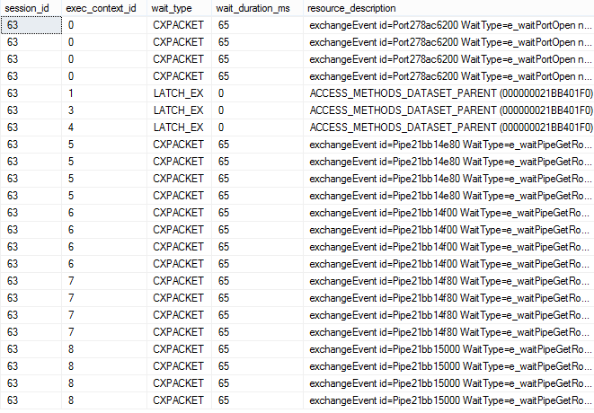
CXPACKET Wait Type
Indicates a SPID is waiting on parallel processes to complete or start
It’s more of a status - not necessarily a problem
Turn off parallelism
EXEC sp_configure 'max degree of parallelism’, 1;
GO
RECONFIGURE WITH OVERRIDE;
GO
select session_id, exec_context_id, wait_type,
wait_duration_ms, resource_description
from sys.dm_os_waiting_tasks
where session_id in
(select session_id
from sys.dm_exec_requests
where wait_type='CXPACKET')
order by session_id, exec_context_id;
ACCESS_METHODS_DATASET_PARENT:
Points to MAXDOP setting
Default is:
max degree of parallelism = 0 (unlimited)
Great article by Paul Randall
Most-common-latch-classes

Slide 52
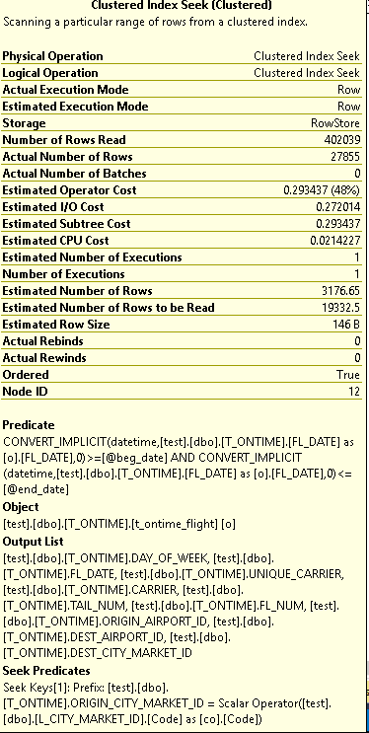
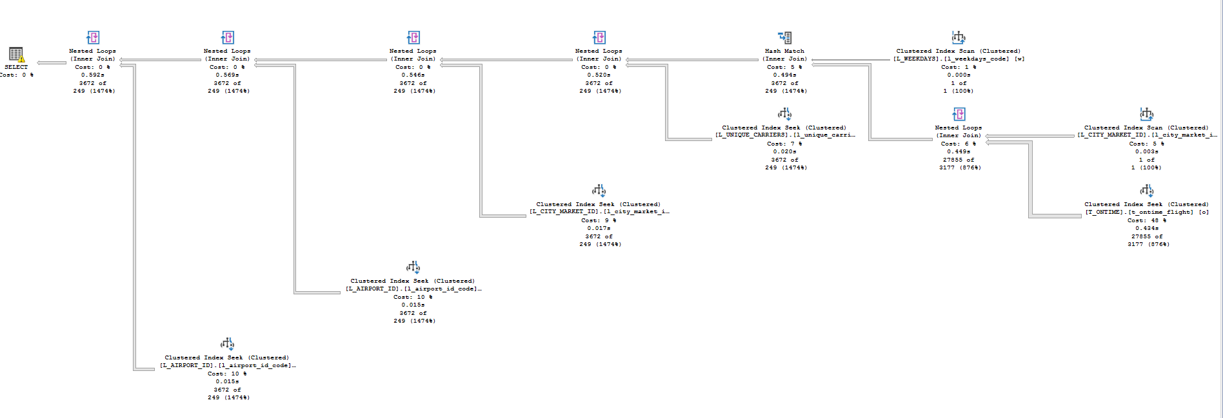
Tune the Query

Slide 53
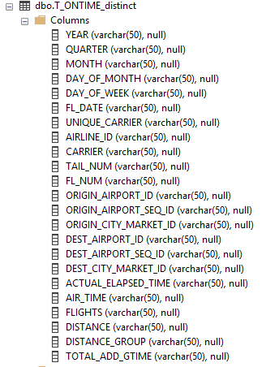
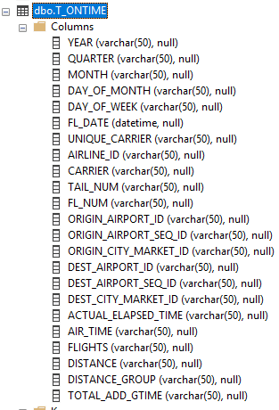
Fix the Datatype

Slide 54
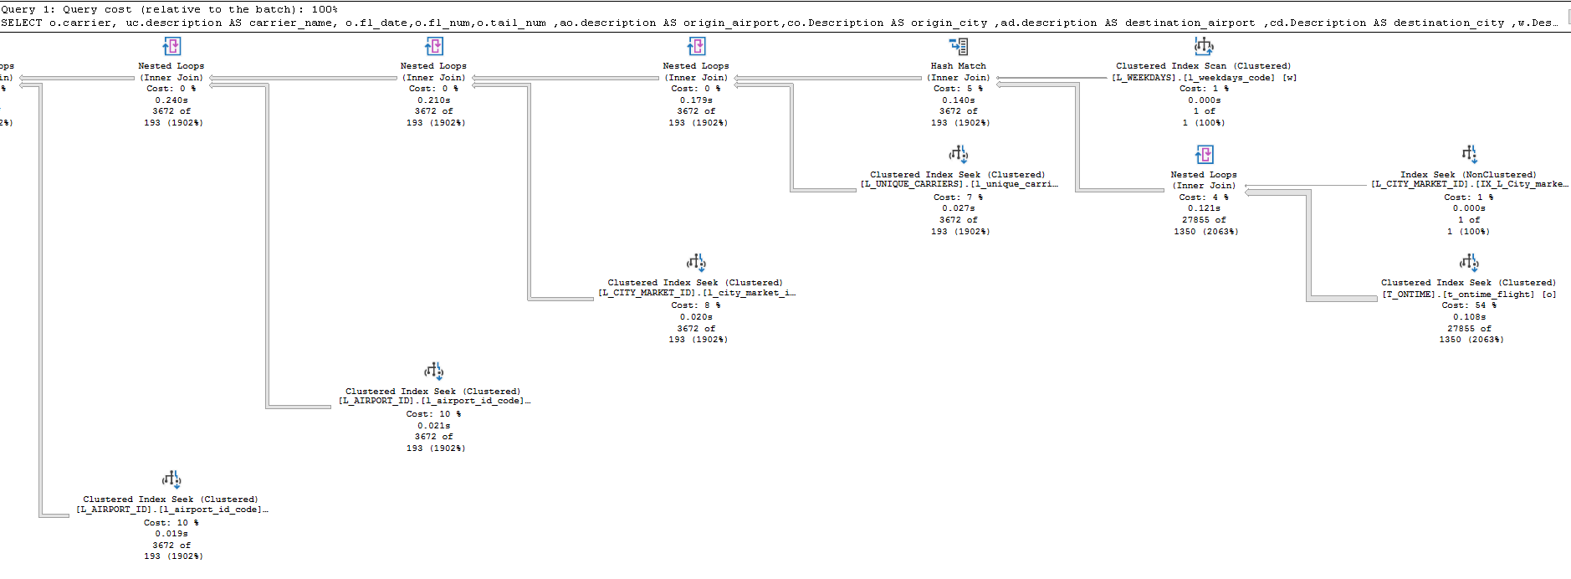
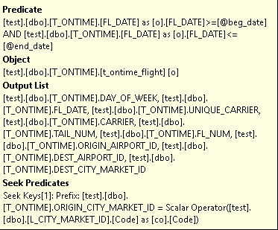
Adjust the index
create index IX_L_City_market_id_desc on L_CITY_MARKET_ID(Description);

Slide 55
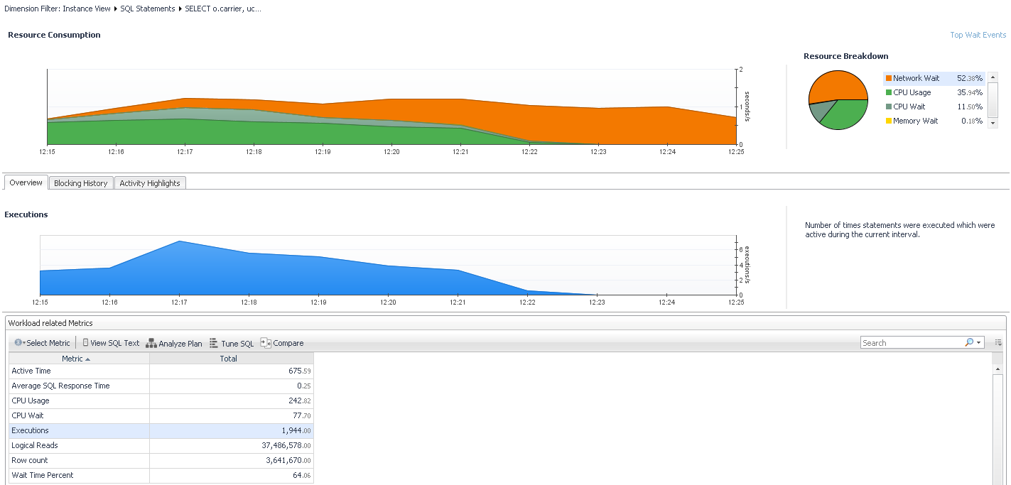
Monitor Tuning Results

Slide 56
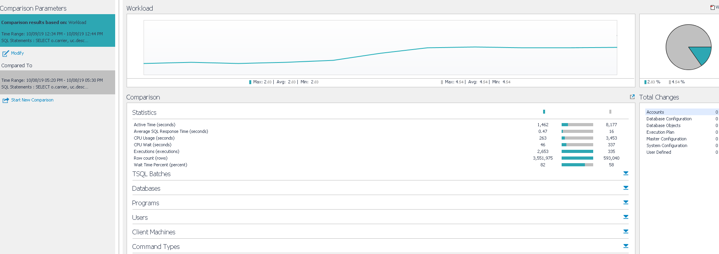
Did We Improve It?
Avg Response: 16 secs to 47 ms
Throughput: 8 x Better

Slide 57
Summary
There’s lots of challenges in Query Tuning
Monitor Wait time
Look at wait types, record baseline metrics
Review the Execution Plan
Look for expensive steps, know what’s supporting the plan
Look for Implicit Conversions, Extra Costly Steps & Bad Database Configurations
Compare your Tuning Results & Brag about Yourself
No one else will!
Q & A

Slide 58
Quest Foglight Free Trial
https://www.quest.com/register/55612/

Slide 59
Foglight Virtual Lab
https://www.quest.com/foglight-virtual-lab/

Slide 60
Save The DATE
ASCEND CONFERENCE 2022
June 12-15, 2022
the Aria in Las Vegas, NV
https://ascendusersconference.com
MOUS 2022
October 26, 2022
Schoolcraft College - VisTaTech Center,
18600 Haggerty Rd, Livonia, MI
https://www.mous.us
THANK YOU
www.mous.us

Slide 61
SURVEYS
Session Surveys
Please complete the session survey for this session using the Zoom session survey link.
The survey link will be provided via email once the webinar is closed.
THANK YOU
WWW.MOUS.US

