Slide 1
MICHIGAN ORACLE USERS SUMMIT 2021
Putting on the Blitz!
Anne Ristau Cooper
Business Analyst
DeKalb County Government - Georgia
Monday October 25 – Thursday October 28, 2021
Virtual event

Slide 2
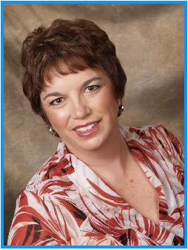
Who am i?
Anne Cooper, you might remember me as Anne Ristau!
User of Oracle Applications since 1989
Developer/Trainer/Analyst
IT Systems Architect with DeKalb County Georgia since 2015
Andy Haack & Beth Skerrett Enginatics

Slide 3
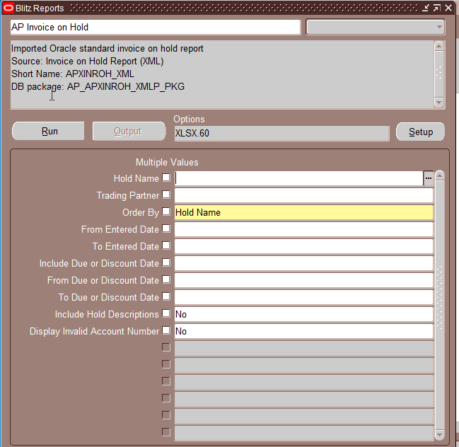
Blitz Reports, a tool that released Information Technology Team from running “special one time queries”
All my output is in EXCEL!

Slide 4
Agenda
Define DeKalb County’s Ask
What is Blitz Reporting
How DeKalb Choose to Implement
Stop the slide deck and let’s see Blitz in action!
Demonstration of Blitz from a User Perspective
Demonstration of Blitz from a Developer Perspective
Q&A

Slide 5
DeKalb County’s Ask
Superuser with access to TOAD/SQL was retiring in 3 months
Users relied on Superuser to run all of her queries on a monthly basis
IT knew nothing of the Superuser’s queries
It needed a fast, inexpensive, user friendly excel replacement for the queries --- AND IT was not going to run anything monthly for the users!

Slide 6
What is Blitz Reporting?
Bought from Enginatics
Integrates beautifully into Oracle Applications (DeKalb is on 12.1.3)
Blitz Reports Appear on Responsibilities
Uses Oracle Profiles for Security
Lots of delivered reports, far better than delivered Oracle Apps Reports!
AdHoc Capabilities (must be able to write SQL)
Templates allow for adhoc design layouts without changing SQL
Version Control
Audit Tracking
Formatted Excel Reports ability to have Macros
Fantastic Customer Support
Priced where I could approve the purchase!!!

Slide 7
How DeKalb Choose to Implement
We tested by taking common scripts and running in TOAD and Blitz, compared the data was the same.
Was versed in the basic creation of reports within ONE DAY just from reading the great documentation
Stood up in Production within the first month of owning licenses
DeKalb purchased 50 licenses;
DeKalb made a Responsibility for Blitz only Reports
DeKalb Users are not “savvy”, they do not go looking for reports!
Allowed me to control our licenses vs giving to every Oracle user
Now on our second year, Financial team and Auditors LIVE in BLITZ
Have not regretted this decision to use Blitz one bit!!!

Slide 8
Some Way Cool Things – Setup
User Profiles
Blitz Report Access
User (can run the reports),
User Admin (can assign reports),
Developer (can create / modify reports)
System (controls the Blitz Interface --- ME!)
Blitz Report Include SQL in XLSX Output – on a parameters TAB
Blitz Report Time Limit in minutes --- poorly run queries will not run past this limit
Blitz Report XLSX Number Format --- to print on reports
Blitz Report XLSX Date Format --- to print on reports
Blitz Report XLSX Column Header Color --- I know it is a Blitz Report by the color!!

Slide 9
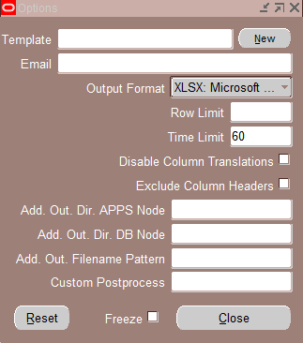
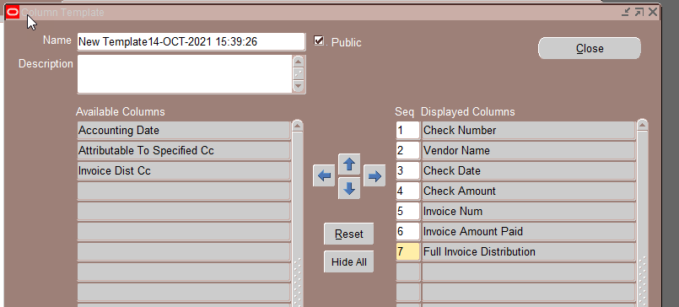
Some Way Cool Things – User Interface
Search by Report Category or Name
Visible Description of the Report
Required Parameters
List of Values on Parameters
Multi-Value Parameters
SAVE my Parameters
Change Columns to Display
Upon Completion Report chooses
Template
To Email
Output Format

Slide 10
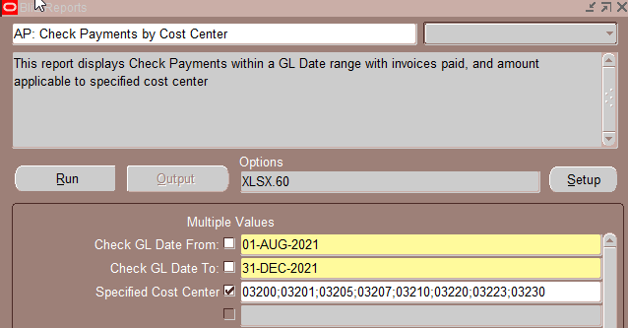
Demo User Interface
AP: Check Payments by Cost Center

Slide 11
Some Way Cool Things – Developer
Set Number format of report if different than defaults
Copied From Name
Who Authored the Report
Limit the Data Number of Rows returned
Limit the Time to Run the report
Descriptive Flexfield for YOUR Audit Requirements
Parameters
Parameter List of Values
Default Values
Assign Report to Site, Application, Operating Unit, Request Group, Responsibility, User, or Form

Slide 12
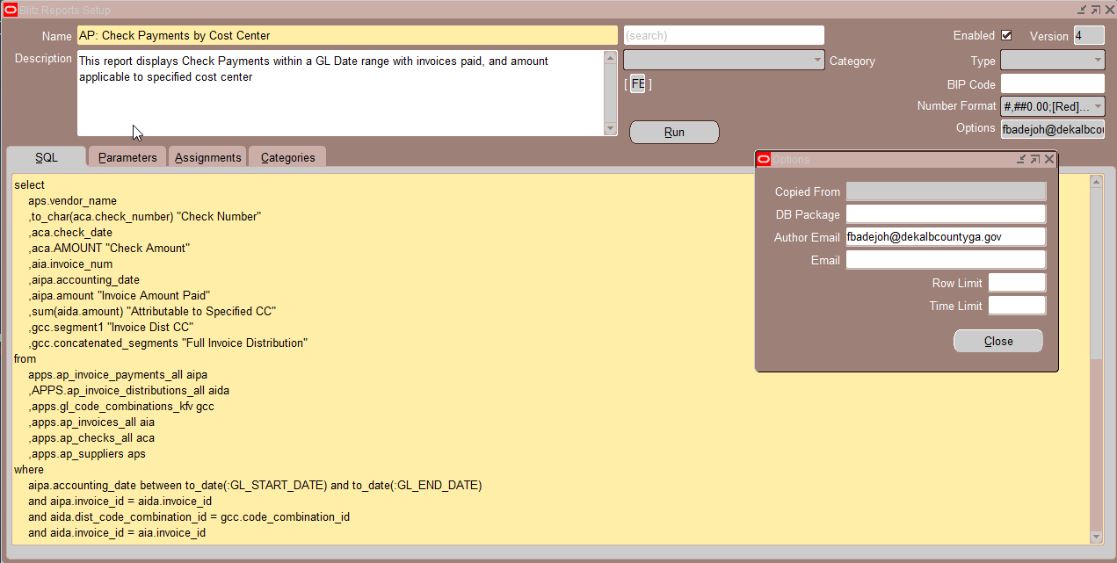
Demo – Developer

Slide 13
Save The DATE
ASCEND CONFERENCE 2022
June 12-15, 2022
the Aria in Las Vegas, NV
https://ascendusersconference.com
MOUS 2022
October 26, 2022
Schoolcraft College - VisTaTech Center,
18600 Haggerty Rd, Livonia, MI
https://www.mous.us
THANK YOU
www.mous.us

Slide 14
SURVEYS
Session Surveys
Please complete the session survey for this session using the Zoom session survey link.
The survey link will be provided via email once the webinar is closed.
THANK YOU
WWW.MOUS.US

Slide 15
Q&A
Anne (Ristau) Cooper
aecooper@dekalbcountyga.gov
(816) 935-8712 personal cell
Blitz contact:
www.Enginatics.com
Beth Skerrett, National Sales Director
(832) 285-2694

