Slide 1
MICHIGAN ORACLE USERS SUMMIT 2020
Cluster, Classify, Associate, Regress: Satisfy Your Inner Data Scientist with OML and Analytics
Jim Czuprynski
President
Zero Defect Computing, Inc.
Monday October 26 – Thursday October 29, 2020
Virtual event

Slide 2
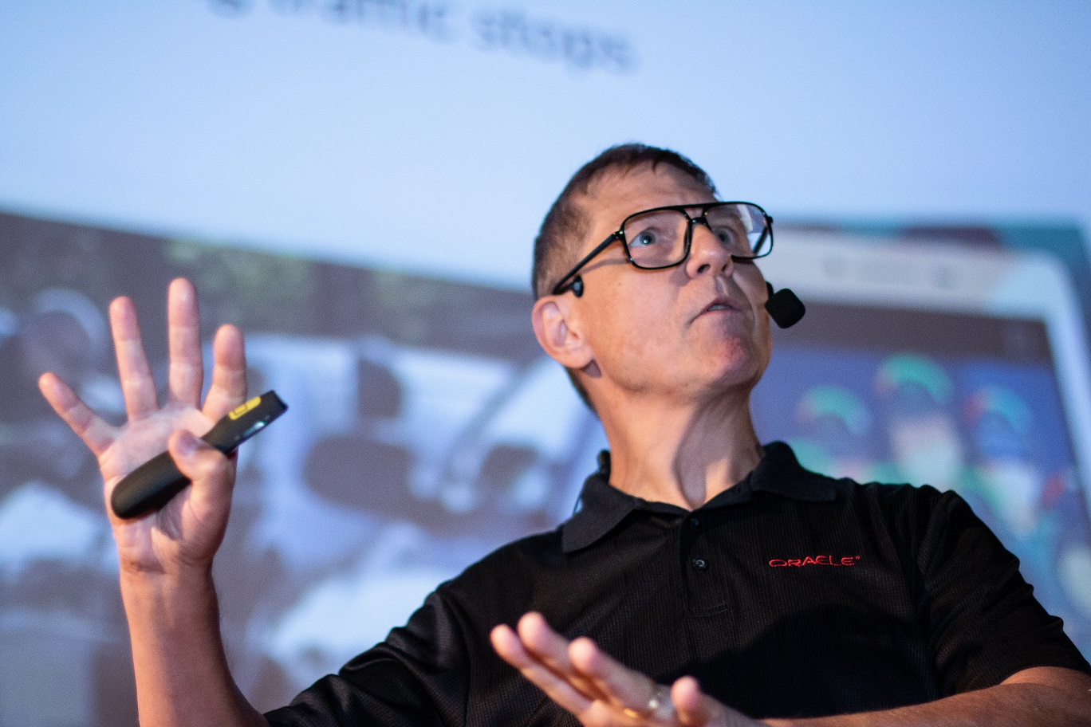
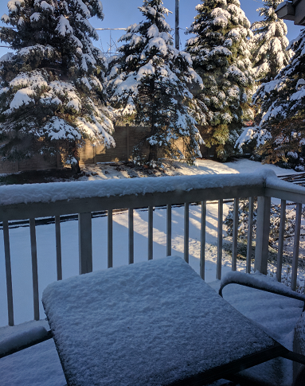
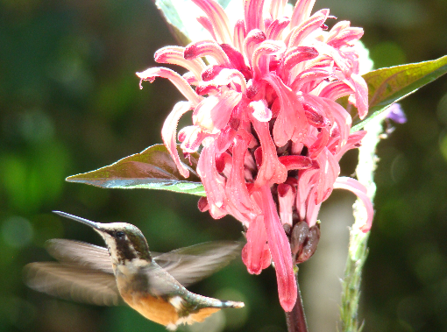
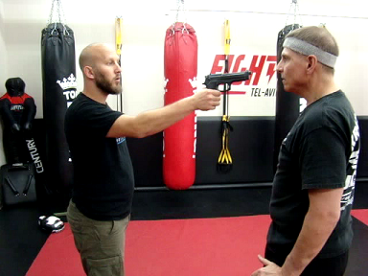
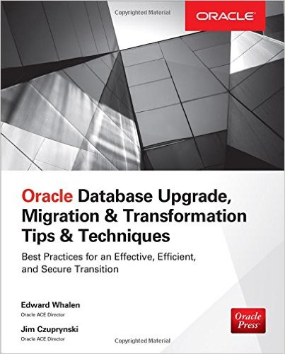
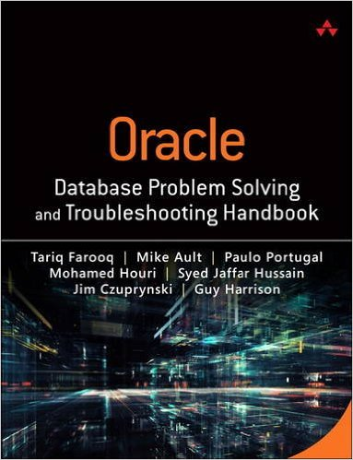
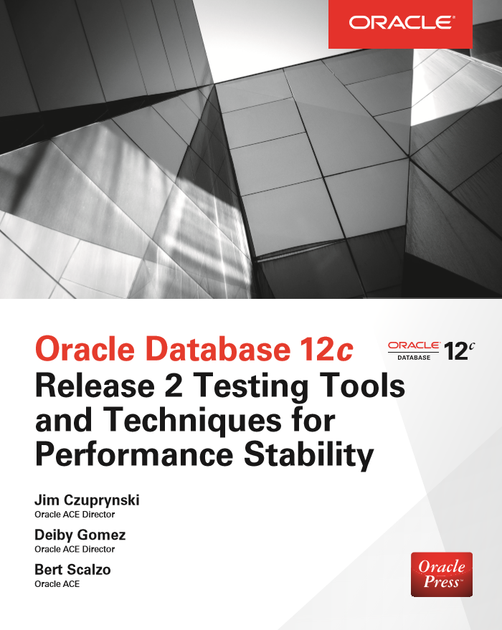
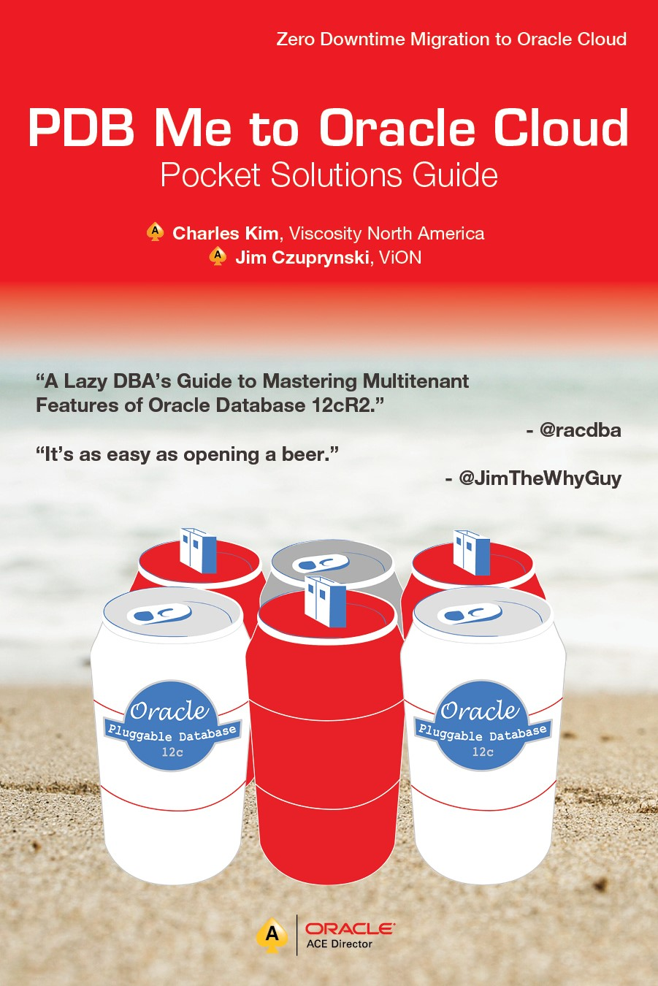
Who Am I, and What Am I Doing Here?
Traveler & public speaker
Summers: Wisconsin
Avid amateur bird watcher
Winters: Illinois
XC skier
Oldest dude in martial arts class
Cyclist
E-mail me at jim@jimthewhyguy.com
Follow me on Twitter (@JimTheWhyGuy)
Connect with me on LinkedIn (Jim Czuprynski)

Slide 4
Typical Business Use Cases Driving Machine Learning & Analytics
Are any of our customers at financial risk to default on their investments in solar panel technology?
Are current solar energy program customers likely to recommend our program to colleagues, or maybe even request more alternative energy sources?
Which customers would be best candidates to take advantage of our solar panel program?
What’s the long-term return our customers can expect to realize on their solar energy investment?
Has the 2020 pandemic hurt our best customers’ ability to continue to invest in alternate energy sources?

Slide 5
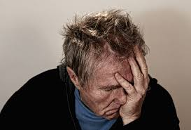
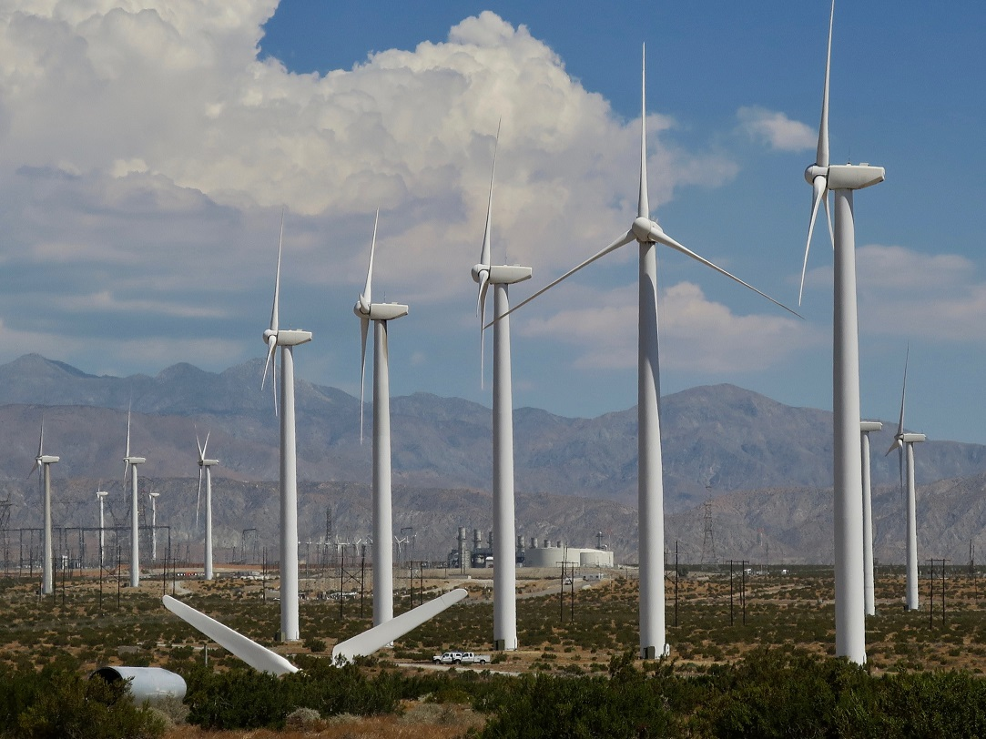
ML Basics: Clustering, Classification, Association, Regression
Classification lets us predict the probability for a single item to belong to a defined category, or even multiple categories
Are any of our customers at financial risk to default on their investments in solar panel technology?
Clustering identifies how certain like items are grouped together into one or more previously undefined categories
Which customers would be best candidates to take advantage of our solar panel program?
Association discovers the chance that two or more items are likely to be found within the same collection as well as the relationships between those items
What’s the long-term return our customers can expect to realize on their solar energy investment?
Are current solar energy program customers likely to recommend our program to colleagues, or maybe even request more alternative energy sources?
Regression gives us the power to project trends forward in time within upper and lower confidence boundaries
Check out this summary that breaks out all of the inherent algorithms that support these methods

Slide 6
SIMIOT: A Modern Electric Utility’s Information Model
SMART_METERS Contains information about individual smart meters for which data is being collected
METER_READINGS Individual readings for each smart meter over (often extremely!) short time intervals
BUSINESS_DESCRIPTIONS Describes unique business classifications based on licensing issued
CUSTOMER_DEMOGRAPHICS Demographics for each customer, including ethnicity, minority status, and employee counts
CUSTOMER_FINANCIALS Pertinent financial data for each customer, including credit worthiness
CUSTOMER_RESPONSES Selected social media posts reflecting how customers anonymously view services & products
DISPATCH_CENTERS Utility repairs depots from which servicepeople & trucks are dispatched

Slide 7
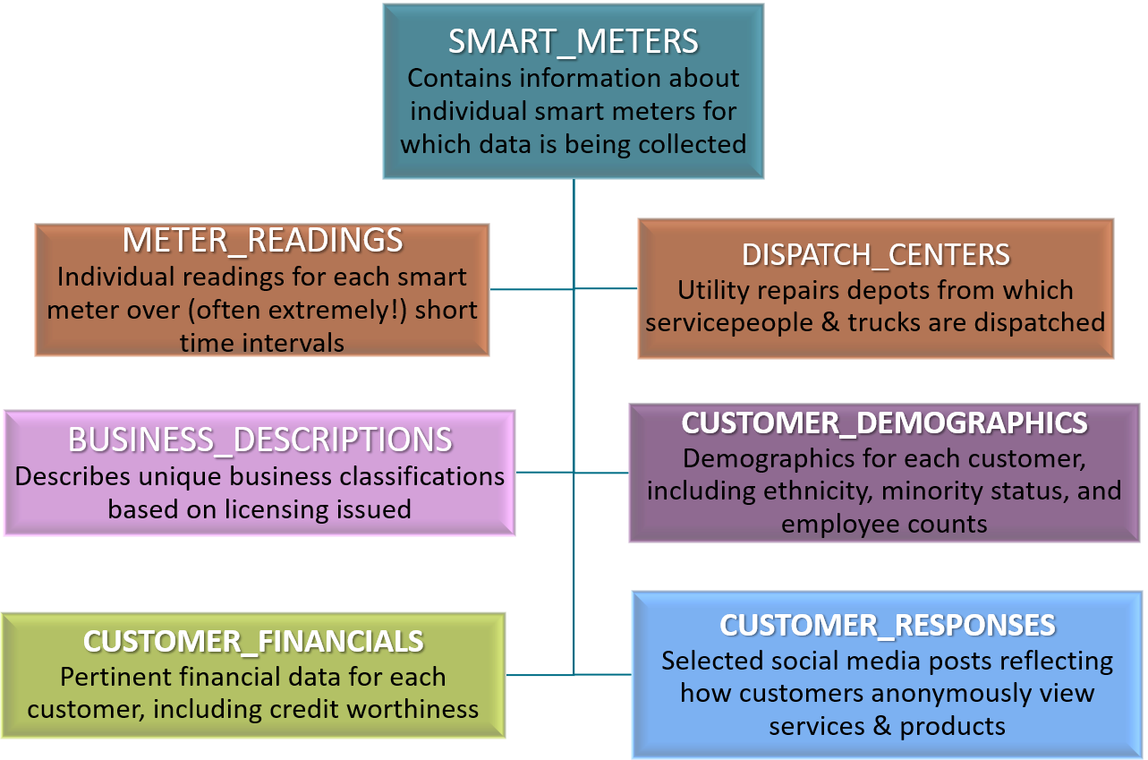
Probing Data Sources, Wherever They Live And What They Comprise
Stored in an Excel spreadsheet … “somewhere”
Pulled from City of Chicago public records via API calls, saved as CSVs and (re)loaded quarterly
Captured from an OSS stream - 10K readings every minute
Don’t forget the customer survey results!
- Marge Innovera, Lead Marketing Statistician
Most recent data within database, but history available as CSV files in Amazon S3 bucket (which cannot be moved!)
Captured via Twitter API stream, stored as multiple JSON documents

Slide 8
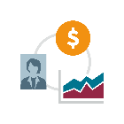
Converged Database: A Vision for the Future, 21c and Beyond
IoT and Edge Computing
Data Integration
Data Management
Business Analytics
Ad hoc, Batch or Scheduled
ADW
ATP
OAC, OML, APEX, and Graph Studio
Business Leaders
Personal / External Datasets
Analysts
AJD
AGD
REST-Enabled External APIs
Self-service analytics via ML
Data
Scientists
OAC Dataflow, Manual or ETL
Self-sufficient, encrypted, secured data storehouse
Developers
Enterprise Applications
The new kid on the block: Autonomous JSON Database
Recently announced: Autonomous Database for Graph Studio
AutoML features make it simple to apply the right algorithm(s) with confidence
ERP
CRM
HCM

Slide 9
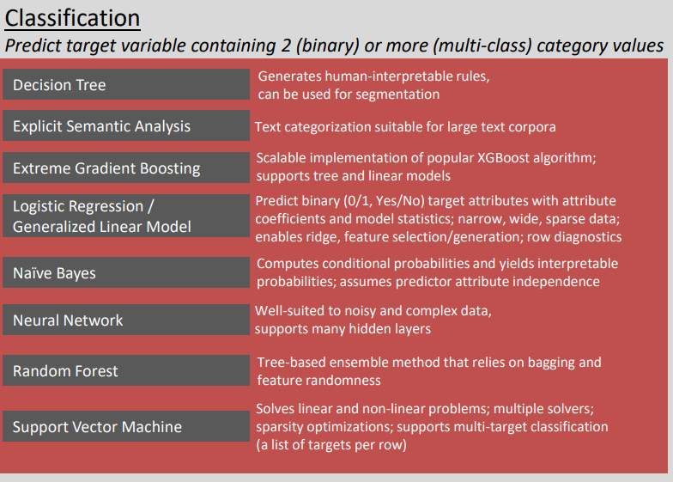
Picking the Right Algorithm: An Algorithm Would Be Nice …
Here’s the good news: There’s at least one powerful Machine Learning algorithm to choose from for any analytic scenario
Here’s the bad news: You’ve got to pick the right one considering its advantages and drawbacks for each scenario

Slide 10
Uncover Associations From Customer Survey Results (1)
CS_ID CS_POSITIVE_RESPONSE
---------- -------------------------
. . .
2633595 PlanningToRenew
2633595 WindTurbineInterest
2635273 PlanningToRenew
2635273 RecommendedToColleague
2635273 WindTurbineInterest
2635712 PlanningToRenew
2637099 PlanningToRenew
2637464 PlanningToRenew
2637464 WindTurbineInterest
2637995 PlanningToRenew
2637995 RecommendedToColleague
2637995 WindTurbineInterest
. . .
Our marketing department recently surveyed the top 100 users of our solar power initiative. Some were excited enough to recommend it to others, and some even want to expand to wind turbines …
… and others, not so much.

Slide 11
Uncover Associations From Customer Survey Results (2)
DECLARE
-- Processing variables:
SQLERRNUM INTEGER := 0;
SQLERRMSG VARCHAR2(255);
vcReturnValue VARCHAR2(256) := 'Failure!';
v_setlist DBMS_DATA_MINING.SETTING_LIST;
BEGIN
v_setlst('ALGO_NAME’) := 'ALGO_APRIORI_ASSOCIATION_RULES';
v_setlst('PREP_AUTO’) := 'ON';
v_setlst('ASSO_MIN_SUPPORT') := '0.04';
v_setlst('ASSO_MIN_CONFIDENCE') := '0.1';
v_setlst('ASSO_MAX_RULE_LENGTH'):= '2';
v_setlst('ODMS_ITEM_ID_COLUMN_NAME'):= 'CS_POSITIVE_RESPONSE';
. . .
We’ll use the APriori algorithm to uncover any hidden relationships between different responses to our recent customer satisfaction survey …

Slide 12
Uncover Associations From Customer Survey Results (3)
. . .
DBMS_DATA_MINING.CREATE_MODEL2(
MODEL_NAME => 'CUSTOMER_RENEWABILITY'
,MINING_FUNCTION => 'ASSOCIATION'
,DATA_QUERY => 'SELECT * FROM t_survey_results'
,SET_LIST => v_setlst
,CASE_ID_COLUMN_NAME => 'CS_ID');
EXCEPTION
WHEN OTHERS THEN
SQLERRNUM := SQLCODE;
SQLERRMSG := SQLERRM;
vcReturnValue :=
'Error creating new OML4SQL model: ' ||
SQLERRNUM || ' - ' || SQLERRMSG;
DBMS_APPLICATION_INFO.SET_MODULE(NULL,NULL);
DBMS_OUTPUT.PUT_LINE(vcReturnValue);
END;
/
… using each customer’s ID as the individual case ID for the model

Slide 13
Uncover Associations From Customer Survey Results (4)
SELECT * FROM (
SELECT
rule_id
,antecedent_predicate antecedent
,consequent_predicate consequent
,ROUND(rule_support,3) supp_rtg
,ROUND(rule_confidence,3) conf_rating
,NUMBER_OF_ITEMS num_items
FROM dm$vacustomer_renewability
ORDER BY rule_confidence DESC, rule_support DESC
)
WHERE ROWNUM <= 10
ORDER BY rule_id, antecedent, consequent;
A very simple query against the results of the Association model shows the individual support and confidence ratings for each survey response
RULE_ID ANTECEDENT CONSEQUENT SUPP_RTG CONF_RATING NUM_ITEMS
------- ---------------------- ------------------------ -------- ----------- ----------
1 RecommendedToColleague PlanningToRenew .172 .895 2
2 PlanningToRenew RecommendedToColleague .172 .179 2
3 WindTurbineInterest PlanningToRenew .818 .953 2
4 PlanningToRenew WindTurbineInterest .818 .853 2
5 WindTurbineInterest RecommendedToColleague .162 .188 2
6 RecommendedToColleague WindTurbineInterest .162 .842 2
Notes:
Support is a measure of how frequently two items occur within the same transaction. Thus, a support rating of .818 for Rule #3 means that a customer’s interest in wind turbines and expectation to renew their solar power service is likely to occur 81.8% of the time in a transaction based on this model’s results.
Confidence is a measure of how often the antecedent and the consequent appear within the same transaction. Thus, for Rule #4, there is 85.3% confidence that a customer’s expectation to renew their solar power service implies they are likely to be interested in wind turbines.

Slide 14
Clustering, Brute Force: Looking for Solar Power Super-Users (1)
CREATE OR REPLACE VIEW solar_superusers AS
SELECT
sm_business_type
,sm_zipcode
,sm_id
,ROUND(AVG(smr_kwh_used),2) avg_kwh_used
,ROUND(AVG(smr_solar_kwh),2) avg_solar_kwh
,ROUND(AVG(smr_solar_kwh) / AVG(smr_kwh_used) ,2) pct_solar
,CASE
WHEN ROUND(AVG(smr_solar_kwh) / AVG(smr_kwh_used) ,2) >= 0.15
THEN 1 ELSE 0
END as solar_superuser
FROM
t_smartmeters
,t_meter_readings
WHERE smr_id = sm_id
GROUP BY sm_business_type, sm_zipcode, sm_id
ORDER BY sm_business_type, sm_zipcode, sm_id
;
We’ll use this metric to identify which SmartMeter customers are solar energy super-users (defined as 15% or more of their energy generated via solar power on-site)

Slide 15
Clustering, Brute Force: Looking for Solar Power Super-Users (2)
DECLARE
-- Processing variables:
SQLERRNUM INTEGER := 0;
SQLERRMSG VARCHAR2(255);
vcReturnValue VARCHAR2(256) := 'Failure!';
v_setlist DBMS_DATA_MINING.SETTING_LIST;
BEGIN
v_setlist('ALGO_NAME') := 'ALGO_KMEANS';
v_setlist('PREP_AUTO') := 'ON';
v_setlist('KMNS_DISTANCE') := 'KMNS_EUCLIDEAN';
v_setlist('KMNS_DETAILS') := 'KMNS_DETAILS_ALL';
v_setlist('KMNS_ITERATIONS') := '3';
v_setlist('KMNS_NUM_BINS') := '10’;
. . .
We’ll use a k-Means algorithm to delve into which Smart Meters are clustered together, based on various attributes of the companies using them …

Slide 16
Clustering, Brute Force: Looking for Solar Power Super-Users (3)
. . .
DBMS_DATA_MINING.CREATE_MODEL2(
model_name => ‘SOLAR_SUPERUSERS_CLUSTERING',
mining_function => 'CLUSTERING',
data_query => 'SELECT * FROM solar_superusers',
set_list => v_setlist,
case_id_column_name => 'SM_ID');
EXCEPTION
WHEN OTHERS THEN
SQLERRNUM := SQLCODE;
SQLERRMSG := SQLERRM;
vcReturnValue :=
'Error creating new OML4SQL model: ' ||
SQLERRNUM || ' - ' || SQLERRMSG;
DBMS_APPLICATION_INFO.SET_MODULE(NULL,NULL);
DBMS_OUTPUT.PUT_LINE(vcReturnValue);
END;
/
… and leverage the view we just created as the source for each Smart Meter’s related attributes

Slide 17
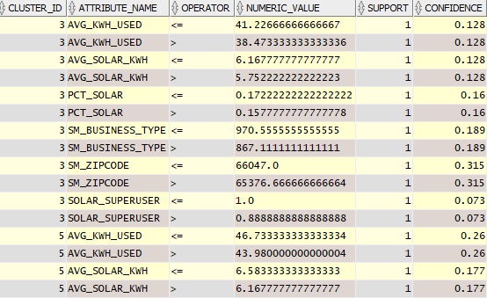
Clustering, Brute Force: ML Modeling Results
SELECT
cluster_id
,attribute_name
,operator
,numeric_value
,support
,ROUND(confidence,3) confidence
FROM dm$vrsolar_superusers_clustering
WHERE cluster_id IN (SELECT cluster_id
FROM dm$vdSOLAR_SUPERUSERS_CLUSTERING
WHERE left_child_id IS NULL AND right_child_id IS NULL)
ORDER BY
cluster_id
,attribute_name
,operator
,numeric_value;
Essentially, these are the rules that drive the clustering model to assign each subset of customers to a specific cluster
Now that the clustering model is complete, we can review which features were grouped together, as well as the support and confidence ratings for their placement in each of the several clusters

Slide 18
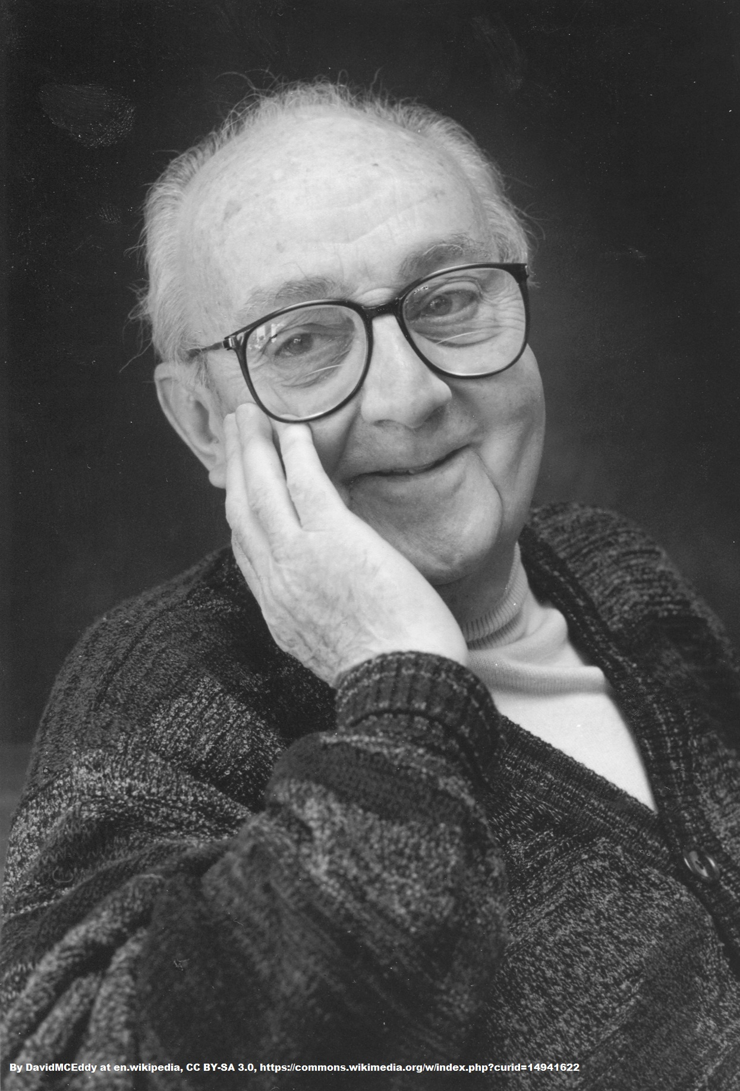
Missed It By That Much: Determining ML Model Accuracy
All models are wrong, but some are useful.
- George E.P Box Founder, Department of Statistics, UW- Madison
The good news: All Oracle Data Mining functions offer transparency into exactly how results have been produced via accuracy determination methods specific to each mining function
Mining Function | Accuracy Determination Methods
Clustering | Centroid
Classification | Confusion Matrix, Lift, ROC
Regression | Root Mean Squared Error (RMSE), Mean Absolute Error (MAE)
Time Series | Mean Square Error (MSE)

Slide 19
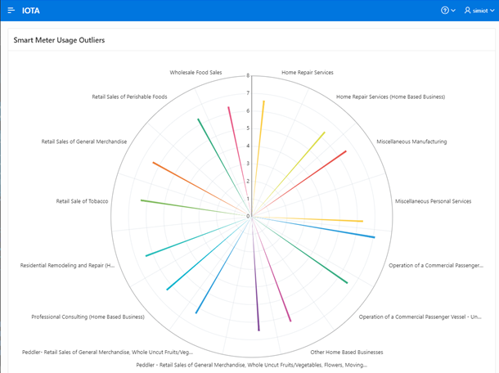
Missed It By That Much: Determining ML Model Accuracy
Here’s an example of using a Radar Area graph to show the top 15 business types that are the most egregious outliers in terms of solar power used (aka distance from centroid)

Slide 20
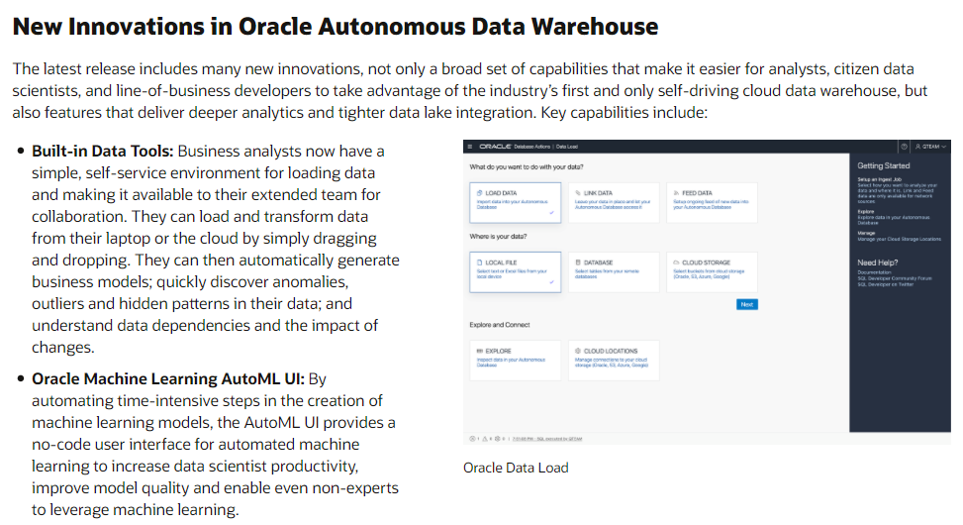
AutoML: Let the Database Decide!
This makes it easier for “citizen data scientists” to apply the power of ML & Analytics …
… the new AutoML interface makes selection of the proper algorithms a snap …
… and many more new features, including Graph Studio
Check out the summary of all the latest AutoML enhancements!

Slide 21
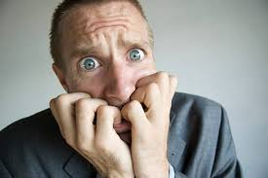
Classification Via AutoML: A Demonstration
To illustrate how powerful a tool AutoML is, let’s run another experiment against the same data source … but this time aiming at producing models and results aimed at classification rather than regression
What could possibly go wrong?

Slide 22
Building a Data Source for AutoML to Devour
CREATE TABLE t_smartmeter_business_profiles AS
SELECT
sm_id
,CD.cd_minority_owned
,CD.cd_family_generations
,CD.cd_years_in_business
,CD.cd_locale_ownership
,CF.pct_profit_margin
,CF.avg_credit_score
,SM.avg_kwh_used
,SM.avg_solar_kwh
,SM.pct_solar
,SM.solar_superuser
FROM
t_customer_creditscoring CF
. . .
. . .
,t_customer_demographics CD
,(SELECT
sm_id
,ROUND(AVG(smr_kwh_used),2) AS avg_kwh_used
,ROUND(AVG(smr_solar_kwh),2) AS avg_solar_kwh
,ROUND(AVG(smr_solar_kwh) / AVG(smr_kwh_used) ,2) AS pct_solar
,CASE
WHEN ROUND(AVG(smr_solar_kwh) / AVG(smr_kwh_used) ,2) >= 0.15
THEN 1 ELSE 0
END AS solar_superuser
FROM
t_smartmeters
,t_meter_readings
WHERE smr_id = sm_id
GROUP BY sm_id
ORDER BY sm_id) SM
WHERE SM.sm_id = CF.cf_id
AND SM.sm_id = CD.cd_id
ORDER BY sm_id;
We’re drawing on data summarized from a Hybrid Partitioned table containing financial statistics …
… as well as customer demographics and solar energy usage data

Slide 23
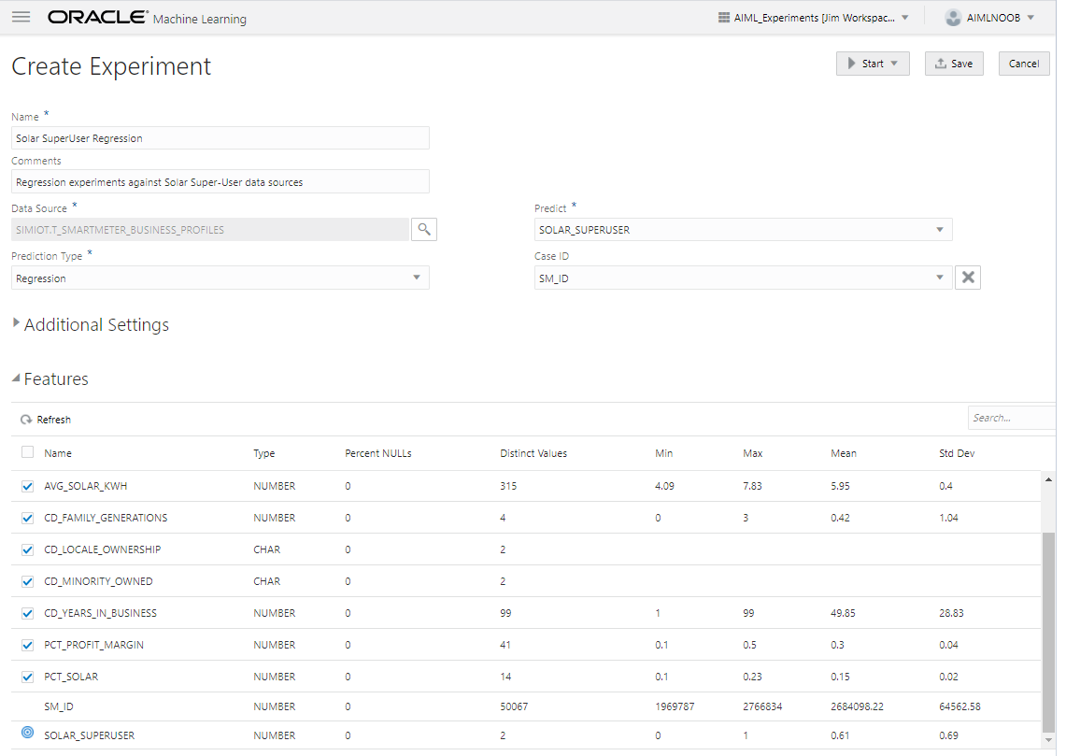
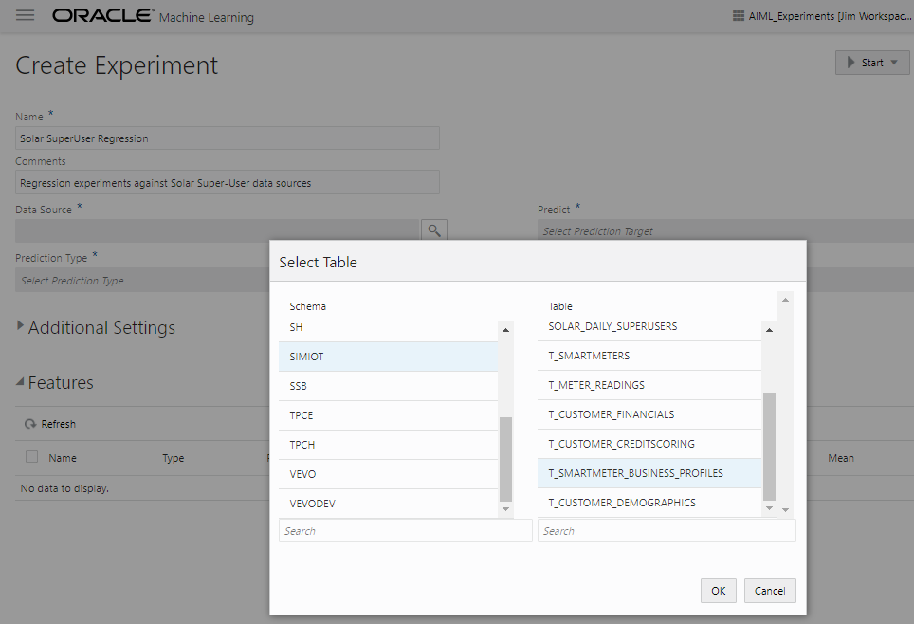
Regression Experiments with AutoML (1)
1
First, select an appropriate data source
2
AutoML automatically builds a list of potential features and their key metrics

Slide 24
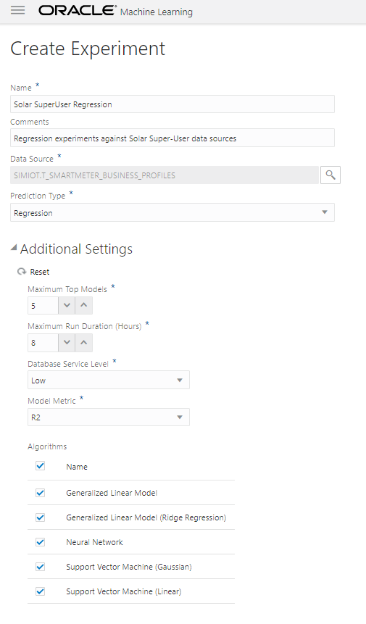
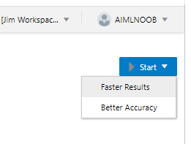
Regression Experiments with AutoML (2)
4
Start the experiment, choosing either speed or accuracy
3
Review settings for prediction type, run time, model metric, and ML algorithms to apply

Slide 25
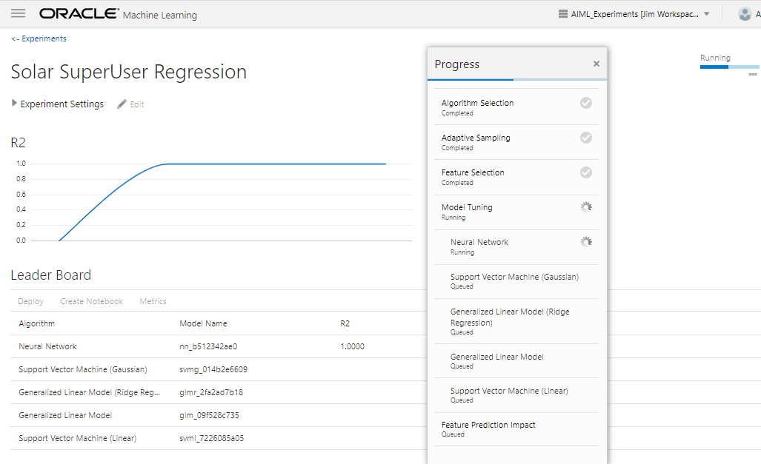
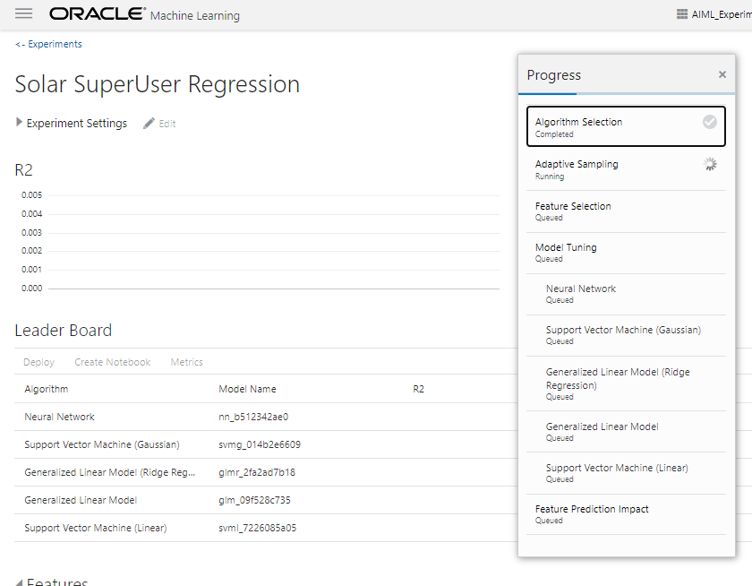
Regression Experiments with AutoML (3)
6
Next, AutoML begins building the selected models
5
AutoML now finishes any sampling needed and moves on to feature selection

Slide 26
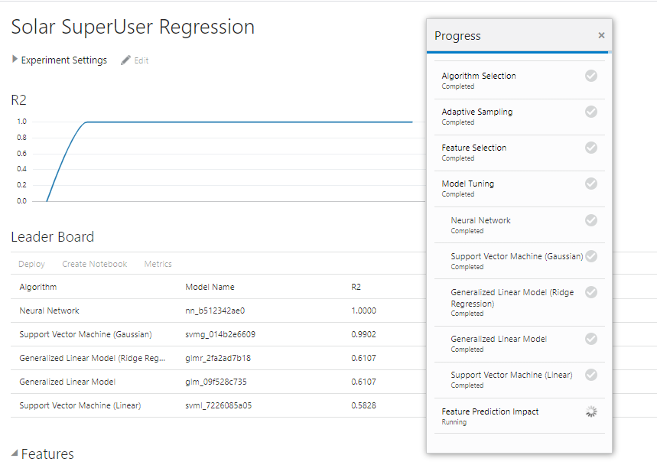
Regression Experiments with AutoML (4)
7
Model generation is complete! On to Feature Prediction Impact assessment …

Slide 27
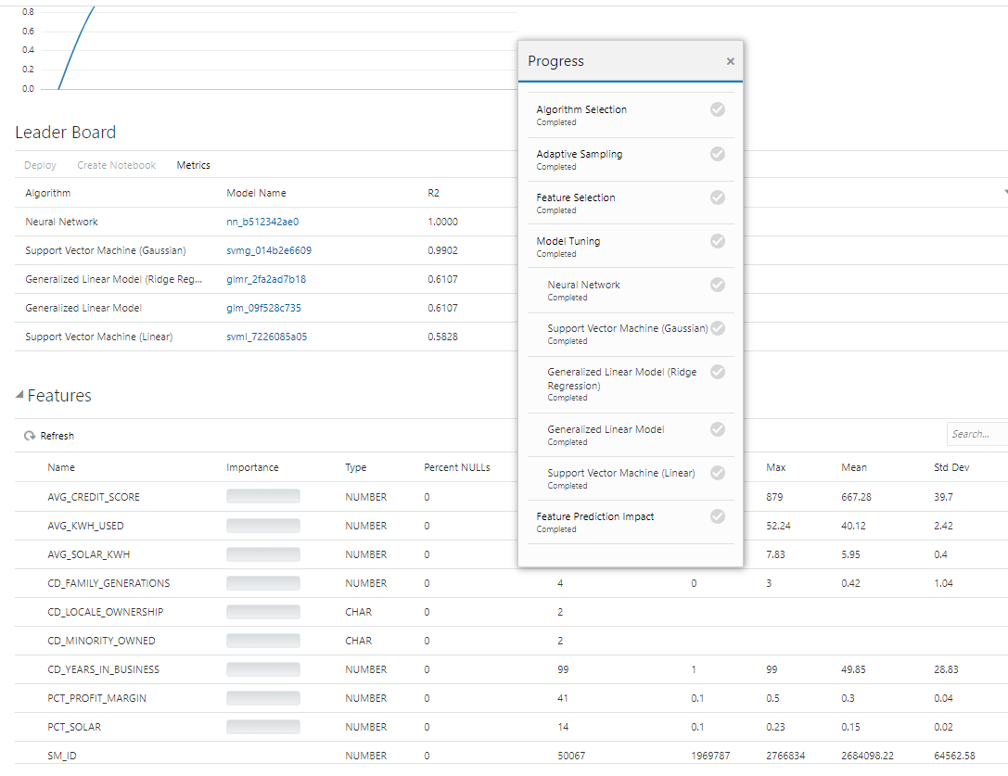
Regression Experiments with AutoML (5)
8
Regression(s) complete! Now let’s transform the Neural Network model into a Zeppelin notebook, with just a few mouse clicks

Slide 28
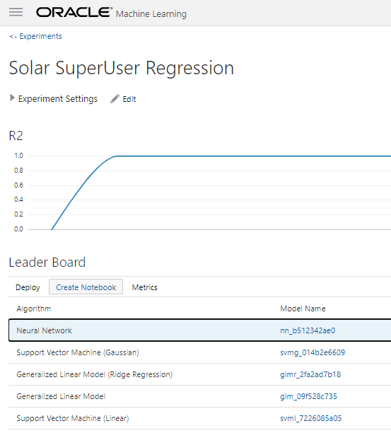
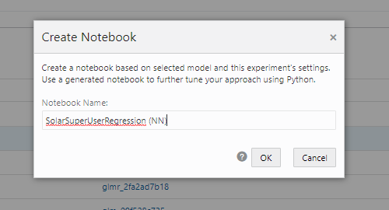
Transform an AutoML Experiment into a NoteBook (1)
2
Name the new notebook
1
From the Leader Board, select one of the algorithms and click on Create Notebook

Slide 29
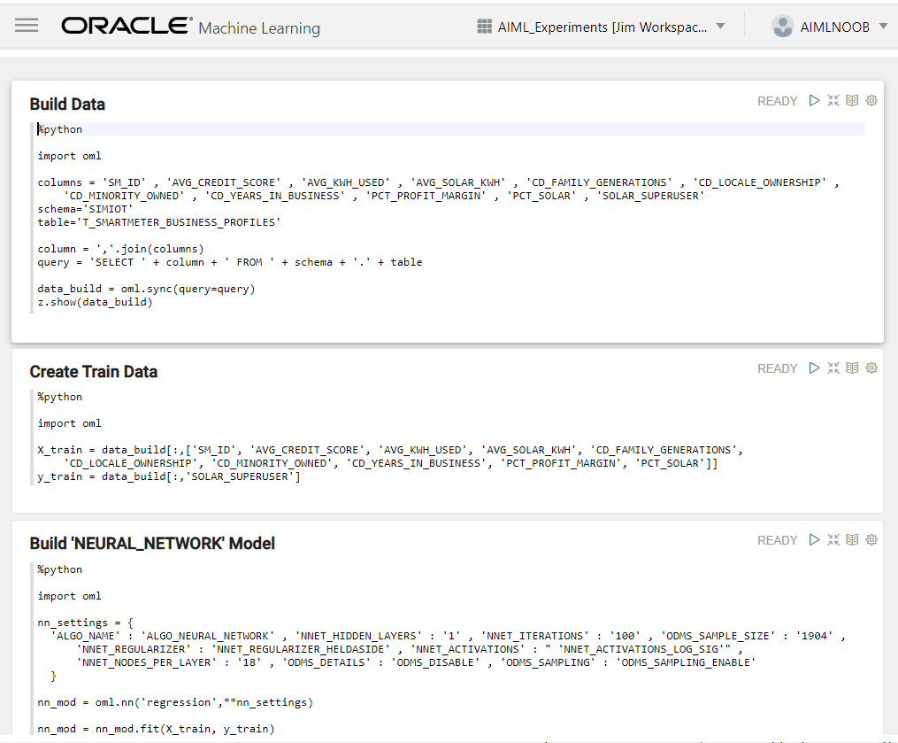
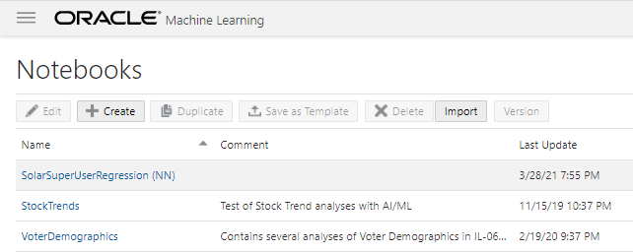
Transform an AutoML Experiment into a NoteBook (2)
4
Don’t know Python? No worries! The new notebook uses OML4Py to construct paragraphs for data retrieval and modeling
3
The new notebook is ready. Click the link to start building paragraphs and retrieving data

Slide 30
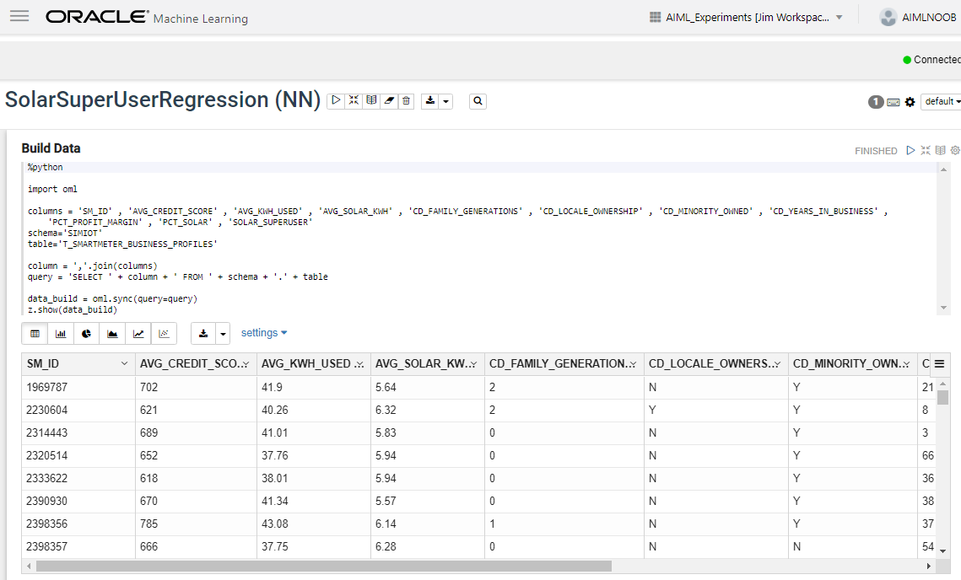
Transform an AutoML Experiment into a NoteBook (3)
5
Et voila! Here’s your first results from a notebook completely generated via AutoML!

Slide 31
Useful Resources and Documentation
OML Algorithms “Cheat Sheet” :
https://www.oracle.com/a/tech/docs/oml4sql-algorithm-cheat-sheet.pdf
Oracle 21c Machine Learning Basics (including AutoML):
https://docs.oracle.com/en/database/oracle/machine-learning/oml4sql/21/dmcon/machine-learning-basics.html
ADW Next Generation Availability Announcement:
https://www.oracle.com/news/announcement/oracle-adds-innovations-to-cloud-data-warehouse-031721.html

Slide 32
Save The DATE
OATUG Forum Live
December 7-11, 2020
Virtual Event
https://forum.oatug.org
THANK YOU
www.mous.us
MOUS 2021
October 27, 2021
Schoolcraft College - VisTaTech Center,
18600 Haggerty Rd, Livonia, MI

Slide 33
SURVEYS
Session Surveys
Please complete the session survey for this session using the Zoom session survey link.
The survey link will be provided via email once the webinar is closed.
THANK YOU
WWW.MOUS.US

